Slide 1

Cyvatar Value Proposition
February 2025
Notes:
Welcome! This video will discuss the Cyvatar Value Proposition for Small and Medium Enterprises. We'll discuss Who Cyvatar is, How to think about the challenges facing SMEs in the Cyvbersecurity space, How the Cyvatar solution addresses those challenges and the typical onboarding process for Cyvatar. In addition to reviewing this video, watch the Solutions Overview video, that goes deeply into the individual Cyvatar solutions and value to customers.
One final note- Althought Cyvatar was built with SMBs in mind, the solution can scale for any business size.

Slide 2
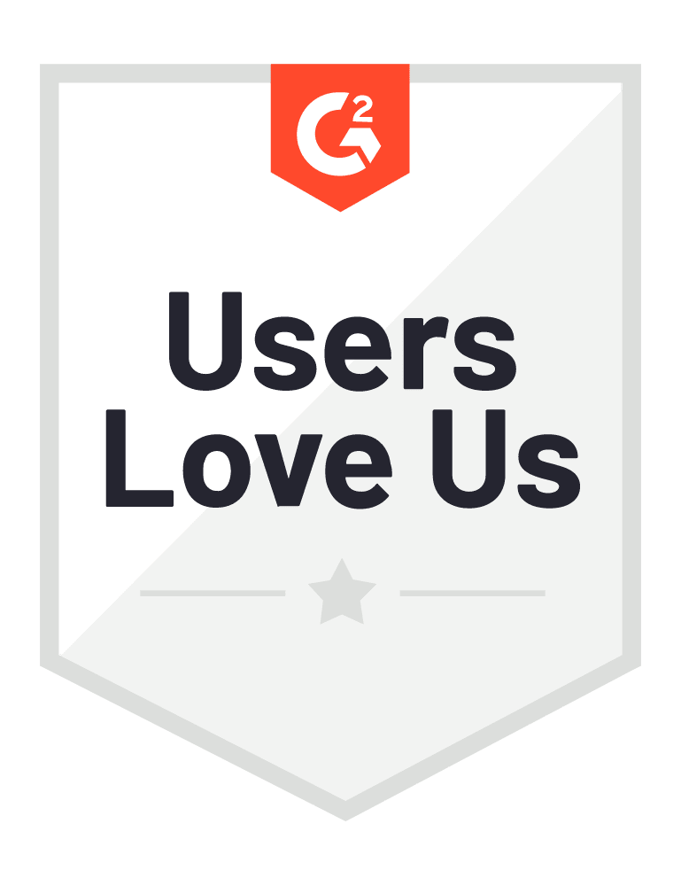
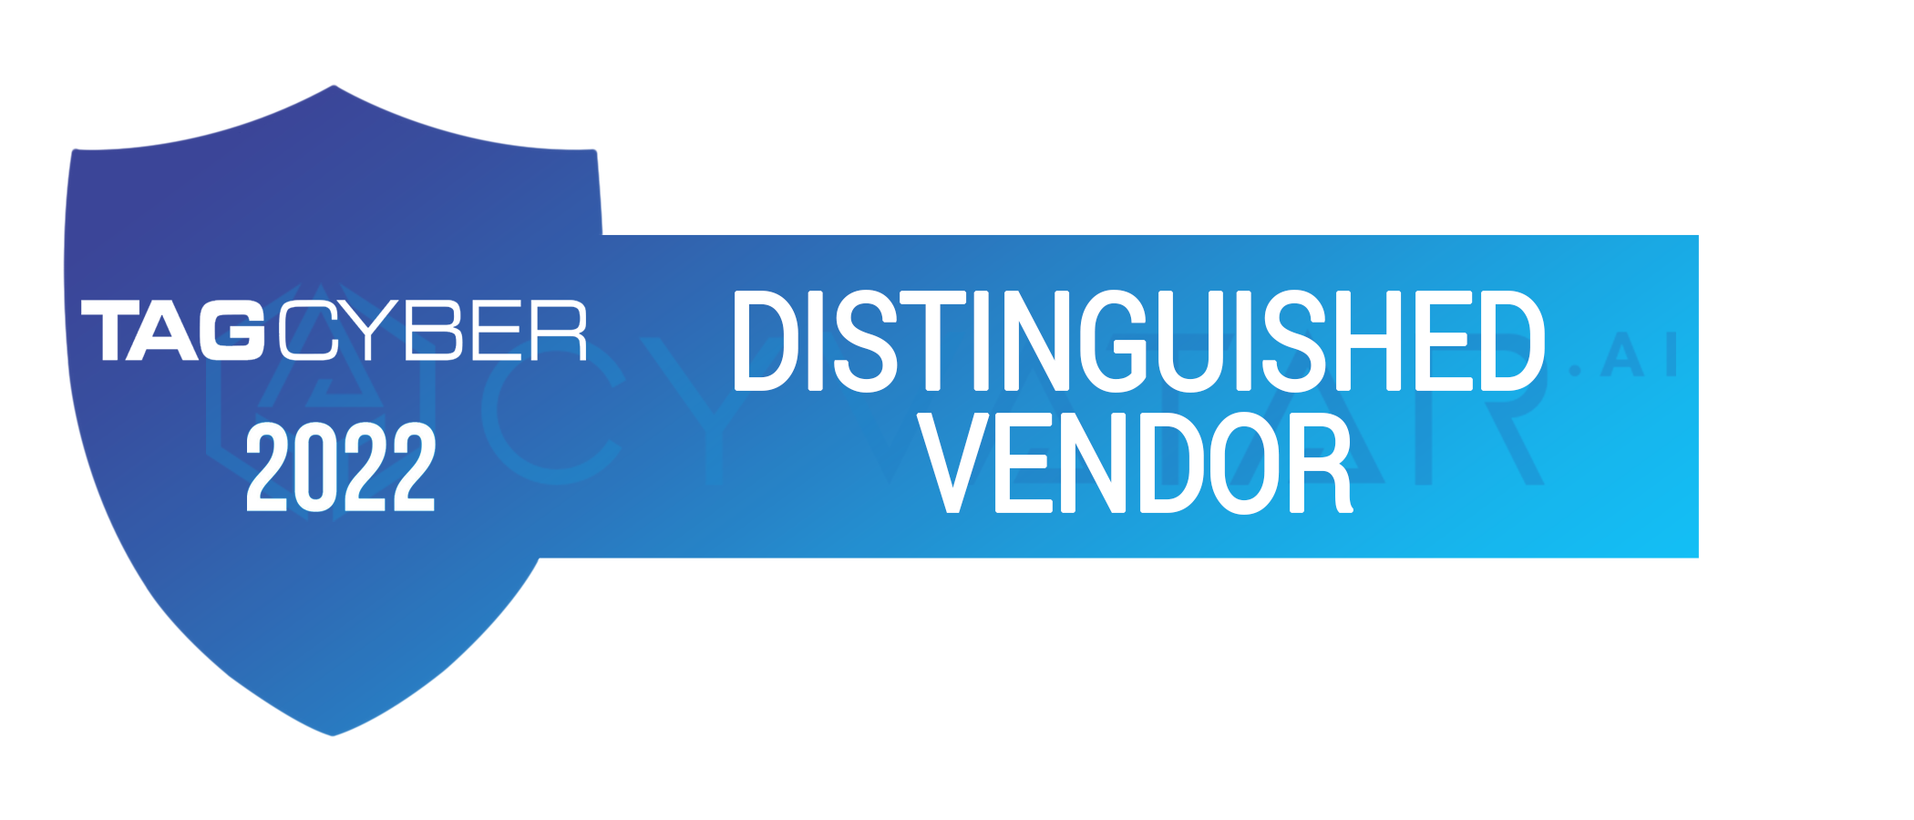



About Us
Cyvatar provides enterprise grade security solutions for the SME market.
Our mission is to ensure that every business no matter their size can access top-tier security, compliance, and insurance services, preventing cyberattacks and promoting a secure business environment.
US Based, launched in 2019
Mastercard's Cybersecurity Partner for SMBs
Award-winning B2B Managed Security Service Provider+
900+ customers
Notes:
Cyvatar is a fully managed cybersecurity platform, integrating threat & vulnerability management, security awareness training, real-time threat monitoring, and much more into a single, intuitive solution.
Launched in 2019, we have customers ranging in size from 5 person micro business to 2,000 employee mid market firms.
In addition to being an awerd winning B2B Managed Security Service Provider, in 2025 we became Mastercard's official Cybersecurity partner for SMBs, replacing MacAfee.

Slide 3
SMBs are Prime Targets
of Cyber Attacks
61%
of SMEs were the target of a cyber attack in 2021
46%
of all cyber breaches were on SMEs
14%
of SMEs have a cybersecurity plan
in place
Notes:
When thinking about the value proposition of Cyvatar for SMEs, a good place to start is SMEs challenges.
The statistics consistently show that SMEs are at a higher risk for a cybersecurity event than larger enterprises.
Read off the %'s
When you combine this with the statistic that only about 14% of SMEs have a cybersecurity plan in place you end up with a high risk environment
46% of all cyber breaches impact businesses with fewer than 1,000 employees.
This is according to Verizon's 2021 Data Breach Investigations Report. [1] The percentage of smaller businesses being hit has climbed steadily in the last few years. An earlier study from Symantec found that 43 percent of 2015 attacks hit businesses with 250 or fewer employees; in 2014, the figure was 34 percent. [18] Factors that continue to make smaller businesses attractive targets to cybercriminals include easier access and fewer security protections in place compared to large enterprises, and the opportunity to receive smaller amounts of money from numerous small or midsize businesses. For one thing, these attacks are unlikely to attract the media and law enforcement attention that attacks on larger companies might.
61% of SMBs were the target of a Cyberattack in 2021.
Not all of these attacks achieved their aim. However, the high percentage of targeted businesses shows how commonly attackers single out SMBs. [2]
47% of businesses that have less than 50 employees don’t allocate any funds towards cybersecurity.
While, 51% of small businesses don’t utilize any IT security measures.
Only 14% of SMBs have a cyber security plan in place.

Slide 4
SMBs Face An Uphill Battle
Insurance Out of Reach
Hard to Maintain
SMBs are risky to ensure
Complex Process
Tech requirements​
Rejection due to a previous breach​
Cancellations of existing policies
High Premiums
Lack Expertise
Costly Staff
Access Limited
No enterprise security
High Prices
Purchase Complexity
Minimums
Notes:
Most of this is driven by the uphill battle SMEs face when trying to secure their business.
SMEs tend to have limited access to enterprise level security products dur to high minimums, high prices and purchase complexity
When they do secure high quality produtcs they then have trouble maintaining these solutions, due to lack of staff or experience is using these solutions
These challenges often lead to SMEs having difficulty securing cyber insurance dur to the complex process and tech requirements. When they do secure insurance, many will have their coverage denied adter a security event because systems were not being properly maintained
These challenges are what Cyvatar is here to solve for.
Most SMBs are too high risk for cyber insurance companies to insure because they lack proper preventative controls.
At least 25% of Cyber insurance holders will make a claim against their policies.
Even if they do secure insurance, insurance companies will reject at least one in four claims for lack of proper controls
60% of small businesses close within 6 months of being hacked.

Slide 5







SOLUTION: ENTERPRISE GRADE CYBERSECURITY FOR SMBS
Fully Managed Solution
We make cybersecurity accessible and effortless for you. No need to hire staff We are your entire cybersecurity team!
Enterprise Technology
Cyvatar works with best-in-class solutions that are pre-vetted for you and can be implemented and configured in 90 days or less.
SMB Friendly Prices
We negotiate our technology offerings to secure our customers the best price regardless of their size
+
Flat Rate, Affordable Insurance
We work with leading Cyber insurance providers to get you access to low cost cyber insurance and help you keep it.
Notes:
Cyvatar is a fully managed cybersecurity platform, integrating various enterprise level technologies at SMB friendly prices into a single solution.
By working with Cyvatar SMBs
Have access to top tier security products, regardless of size
Take the guess work out of building the right security program
Secure 24/7 monitoring and resolution without hiring multiple staff
Secure affordable cyber insurance
Setting them up for a secure business environment

Slide 6



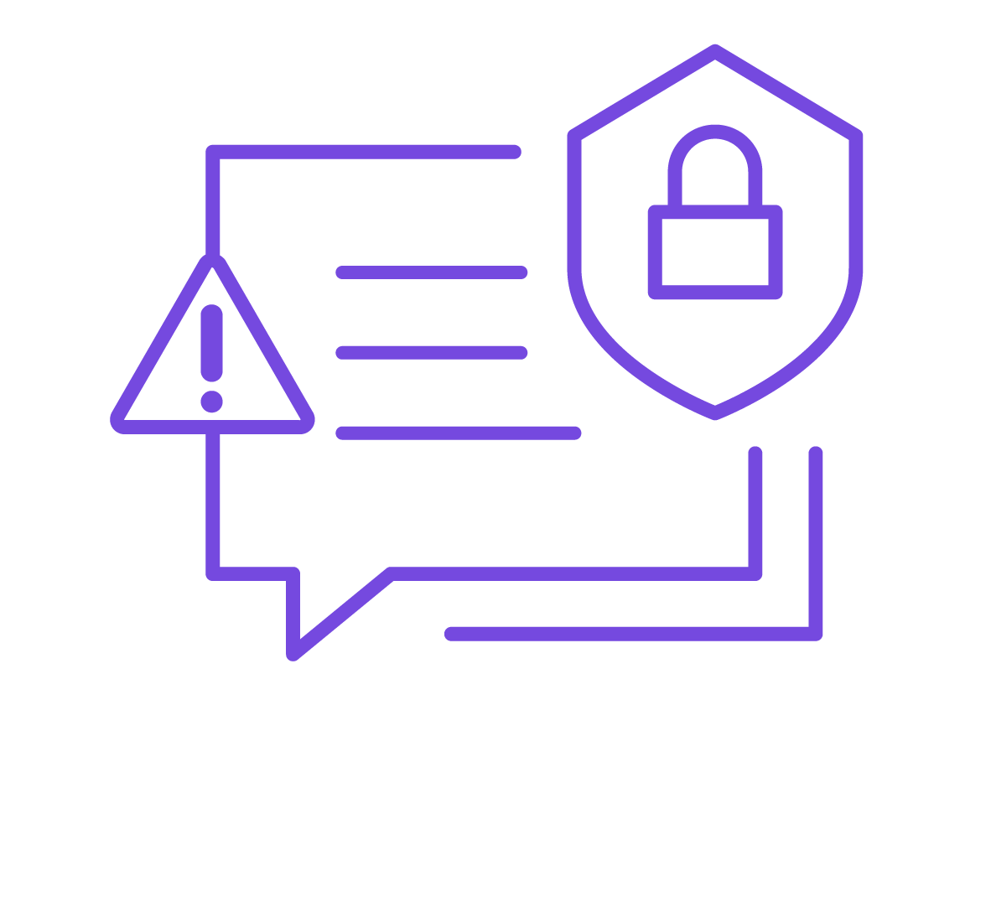

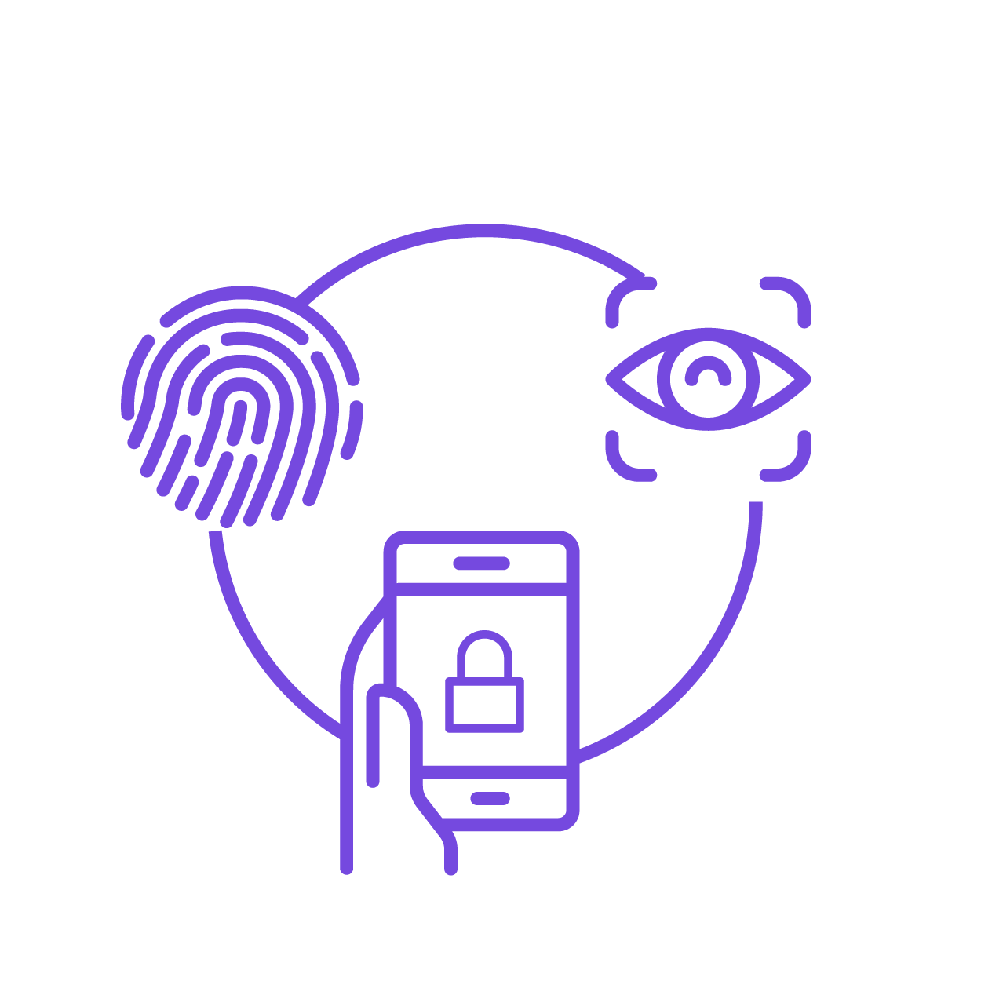
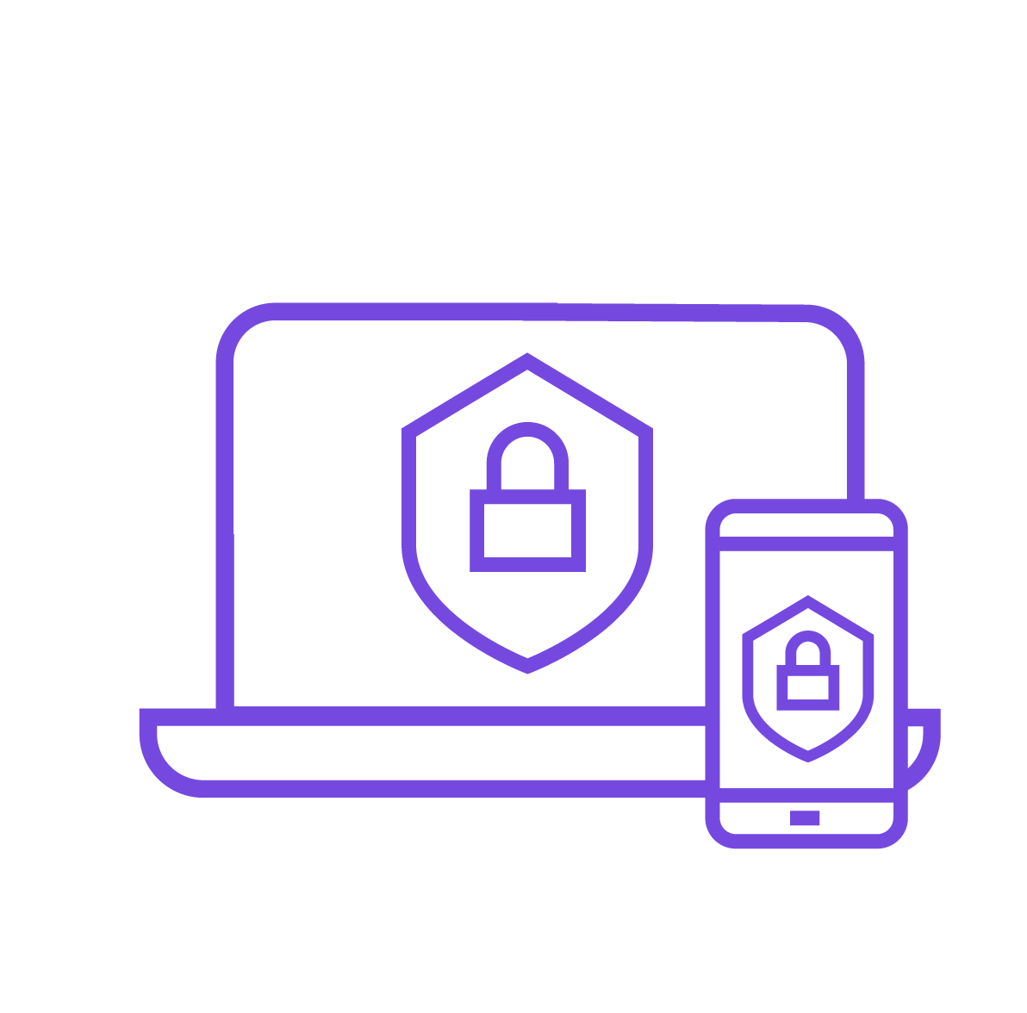


Cloud SaaS Security Management (CSM)
Mobile Threat Defense (MTD)
Preventative Controls
Cyvatar's Comprehensive Solution Portfolio:
Achieve compliance and security for every organization, regardless of size or scope.
From HIPAA, NIST, CIS, to SOC2 compliance, or simply enhancing security, we provide solutions that seamlessly progress your security program from inception to maturity.
IT Asset Management (ITAM)
Threat Vulnerability Management (TVM)
Incident Response Management (IRM)
Email Security Management (ESM)
Multi-Factor Authentication (MFA)
Secure Endpoint Management
(SEM)
Managed Security Awareness & Training (SAT)
DNS Security
Management (DSM)
Notes:
We offer 10+ standard tools and solutions from MFA to Mobile Threat Defernse. You can learn more about our individual solutions in the Solutions Overview Video

Slide 7
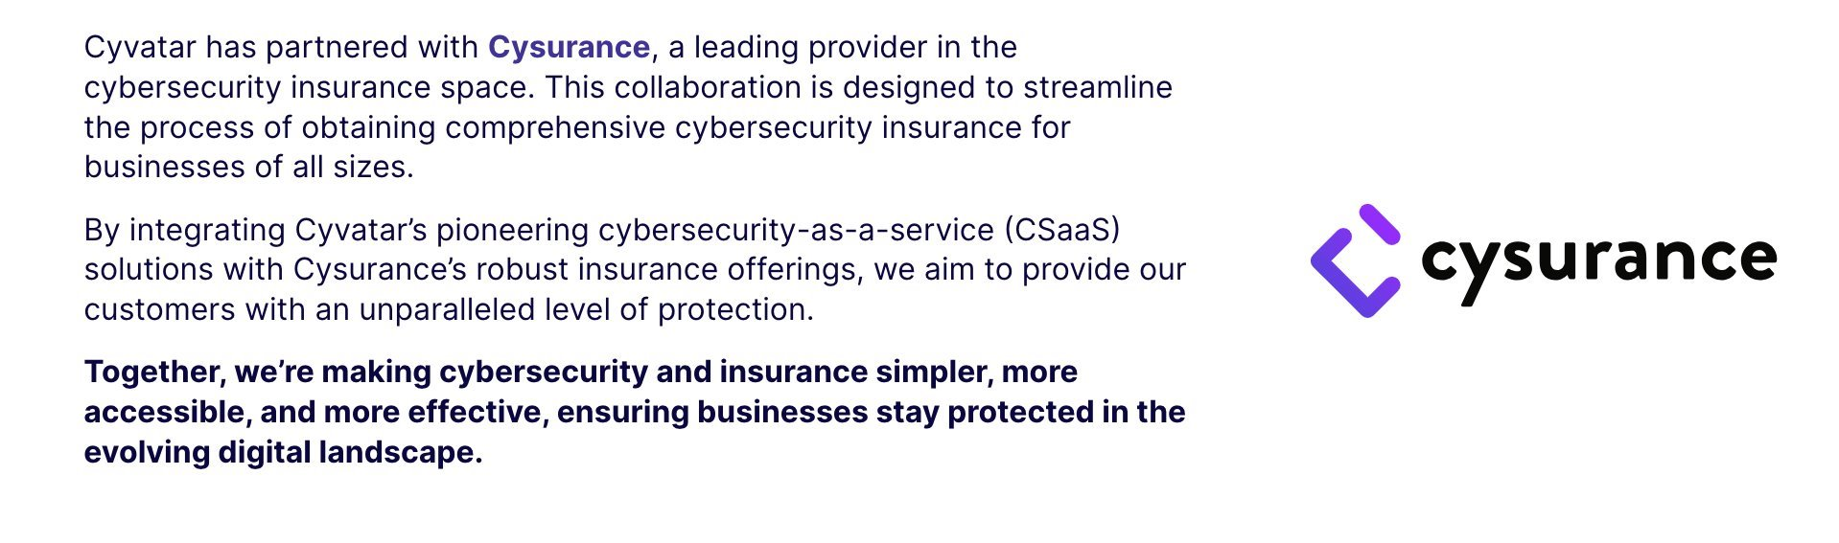
360 Protect
Certification Warranty $500K Program
Qualifying Preventative Cyber Security Controls
As a Cysurance Certified Partner, Cyvatar offers a value-added, Certification Warranty at NO COST TO QUALIFYING CUSTOMERS.
Financial reimbursements up to $500,000 towards recovery expenses for services cost after adopting preventative cybersecurity controls
Threat Vulnerability Management
(TVM)
Secure Endpoint Management
(SEM)
Multi-Factor Authentication (MFA)
Fast Tracked Cyber Insurance
Flat Fee Cyber Insurance $1M Coverage Pricing Options
Being a Cyvatar Member enables an easy pathway to be eligible for highly discounted Cyber Insurance.
Average Discount: 30%
Flat Fee Cyber Insurance $2M Coverage Pricing Options
Flat Fee Cyber Insurance $3M Coverage Pricing Options
Notes:
All Cyvatar Engagements come with a warranty program through our partner Cysurance with TVM, SEM and MFA implementation.
Additionally, Cyvatar customers enjoy an average discount of 30% off Cysurance cyber insurance.

Slide 8
Cyvatar Delivers Outcomes, Not Alerts
1
Protect your Business
Cyvatar does not focus on detection because you cannot get compliant, secure, or insured by detecting. We focus on getting our members secure and staying secure continuously by implementing & maintaining the best-of-breed solutions, which include remediation.
2
Grow your Business - Compliance & Security Questionnaires
Cyvatar has created all its solutions based on compliance requirements and mapped them to those requirements. making it seamless to get our members to a compliance state with our vast network of vCISOs and compliance auditors.
Cybersecurity Insurance
3
Cyvatar continuously delivers the preventative controls that insurance companies require. We have partnered with several top brokers to help our members get insurance.
Notes:
Cyvatar has simplified cybersecurity into the outcomes that you need by choosing the best-of-breed products and tying them to our expert team that implements the people and the process. We deliver three primary outcomes to our members, compliance, continuous preventative controls, and cybersecurity insurance in case preventive controls are bypassed.

Slide 9
Onboarding Experience with Cyvatar

Slide 10
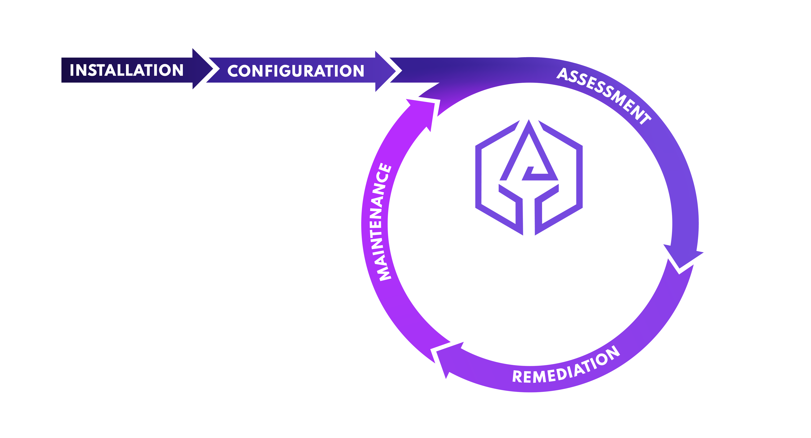
EXCLUSIVELY CYVATAR – ICARM METHODOLOGY
Installation
Our Security Engineers implement the solution.
Configuration​
The solution is configured properly to ensure its functionality.
Assessment
An assessment is performed to identify risks and vulnerabilities.
Remediation
Remediation of the risks that were identified is performed.
Maintenance
Continuous maintenance and monitoring with monthly executive reporting. Repeat.
CYBERSECURITY VALUE IS 90 DAYS OR LESS!
Notes:
MSSPs, MDRs, XDRs DON’T DO THIS – make this clear
What does remediation mean to you?

Slide 11
Cyvatar Onboarding
Week 1
Subscription Initiation & Planning
Weeks 2 - 4
Installation
Weeks 5 - 6
Configuration & Assessment
Weeks 8 -12
Remediation
*Continuous*
Maintenance
Sign up for MyCyvatar
Complete Assessment
Schedule Freemium scans
Download Free Security Policies
Select Solutions to purchase through eCommerce
New Subscription CyvatarPro!
Your Member Experience (MX) Manager will reach out to Welcome you to the CyFamily!
Technical Information
Enable notifications in the Cyvatar Platform and complete the data collection forms for Cyvatar Security Engineers to custom select solution product(s) that best fit your environment.
Configuration
Once installed, Cyvatar Security Engineers will lead configuration efforts based on recommended security best practices and knowledge of your unique environment needs.
Assessment
Security Engineers will assess gaps and risks and will provide recommendations that will be tracked in the Cyvatar Platform.
Remediation
Human driven. Technology assisted. Cyvatar Security Engineers will lead the remediation efforts, continuously reviewing gaps identified through the assessment.
Cyvatar Security Engineers will develop, plan, schedule, and execute remediation until identified gaps are remediated, to the extent reasonably possible.
This will reduce the quantity of issues and actions needed by your team so you can focus on your bottom line.
Maintain Remediated Status
Security Engineers will lead maintenance efforts, continuously assessing the environment & remediating vulnerabilities identified so you can stay safe and compliant.
ROI Visibility
With the Cyvatar Platform you have visibility into Cyvatar’s daily activities that keep you safe, all in one place.
Member Experience
Your MX Manager will stay connected to ensure your Cyber Security journey is aligned with your strategic objectives.
Installation
Acting as an extension of your team, Cyvatar Security Engineers will assist with installation of the relevant 3rd Party Product(s) by providing installation instructions, and hands on guidance. While always having your back through any strategizing or troubleshooting.
ICARM Onboarding Visibility
Progress is tracked through the Cyvatar Platform with the Cybersecurity Value Score, task manager, issues manager, and detailed dashboard.
Monthly Executive Reporting via Cyvatar platform.
Ad-hoc working sessions will be scheduled on as needed basis.

Slide 12

THANK YOU!
Thank you for your time.
Let’s go forward together in securing the future of SMBs.
Contact: [INSERT NAME & EMAIL]

Slide 13
Solution Summaries

Slide 14



|
Certification Warranty $500K Program
Add-On Cyber Insurance
As a Cysurance Certified Partner, Cyvatar offers a value-added, Certification Warranty at NO COST TO QUALIFYING CUSTOMERS.
Being a Cyvatar Member enables an easy pathway to be eligible for highly discounted Cyber Insurance.
Qualifying Preventative Cyber Security Controls
Flat Fee Cyber Insurance $1M Coverage Pricing Options
Annual Company Revenue Levels | Total Annual Premium Cost
$0 - 50M | $1,750
$50 - 100M | $2,750
Threat Vulnerability Management
(TVM)
Secure Endpoint Management
(SEM)
Multi-Factor Authentication (MFA)
Flat Fee Cyber Insurance $2M Coverage Pricing Options
Adopting these preventative cyber security controls will protect your business from the financial costs associated with remediating cyberattacks.
Financial reimbursements up to $500,000 towards recovery expenses for services costs:
Annual Company Revenue Levels | Total Annual Premium Cost
$0 - 50M | $2,950
$50 - 100M | $4,000
Reimbursements | Event Description
$100,000 | Ransomware and business email compromise Events
$100,000 | Compliance and Regulatory Failure Penalties
$50,000 | Business Interruption Loss
$250,000 | Cyber Legal Liability Expenses
Flat Fee Cyber Insurance $3M Coverage Pricing Options
Annual Company Revenue Levels | Total Annual Premium Cost
$0 - 50M | $3,950
$50 - 100M | $5,000

Slide 15





Threat & Vulnerability Management (TVM)
Continuously identify, assess, classify, remediate, and mitigate security weaknesses together with fully understanding root cause analysis to address potential flaws in policy process.
Prevent cybersecurity breaches
How Cyvatar Secures You
Installation and configuration of a vulnerability scanner and patch management system
Continuous vulnerability scanning (including AWS, Azure, GCP) and remediation of threats from a prioritized list
Port Zero – continuous vulnerability scanning of all TCP & UDP 65535 ports open to the internet
Patch management in line with your change control process
Maintenance of the remediated status
Monthly executive reporting
Ongoing patching of network assets
Continuous scanning to detect and fix critical vulnerabilities
Eliminates the need for dedicated resources to deploy and manage
Notes:
Scanning domains and subdomain – why?
Security guards 24/7 running around your building – making laps to ensure the doors are locked, that there are no bags just lying around that are not supposed to.
Locking the door analogy with a Ring Camera – seeing who is trying to come in – your neighbor or best friend is welcome, someone that wants to harm you
If they bad guy can’t make it through the front door they might try to the windows or sliding doors – that’s where we start patching and add different techniques…think window sensors, new locks, etc. – what we call in our world patching
Layer that with us working on a security testing, so as the good guy will try to break in call it a firedrill – which we do once a quarter, have you ever done a pen testing. No or Yes (how much did you spent?)

Slide 16
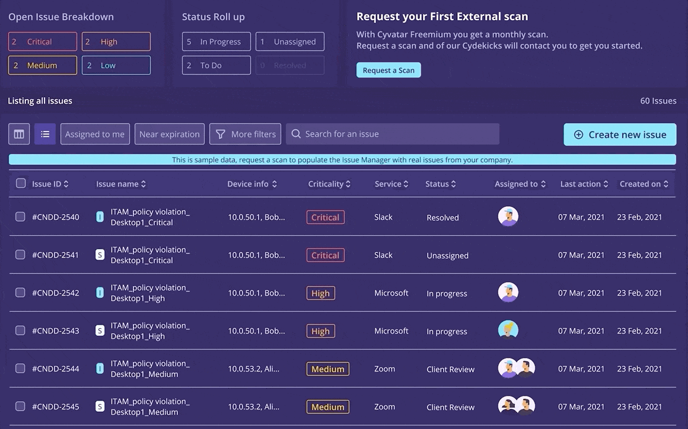
External Pen Testing included with
Threat & Vulnerability Management (TVM)
How Cyvatar Secures You
Choose Quarterly or Annual Penetration Testing
Continuous Protection - incorporates the latest knowledge, methodologies, techniques
Meet compliance requirements with more scheduling flexibility
Part of our Threat & Vulnerability Management (TVM) Solution to ensure we continuously scan and patch and remediate to keep you secure
.
Notes:
Cyvatar has simplified cybersecurity into the outcomes that you need by choosing the best-of-breed products and tying them to our expert team that implements the people and the process. We deliver three primary outcomes to our members, compliance, continuous preventative controls, and cybersecurity insurance in case preventive controls are bypassed.

Slide 17




Secure Endpoint Management (SEM)
A fully managed AI-based antivirus solution. The goal is to proactively secure endpoints from malware attacks and achieve a preventative state so that malware attacks are blocked before they can execute, as opposed to detect and respond.
Prevention of malware & ransomware incidents
How Cyvatar Secures You
Installation and configuration of an endpoint security solution
Remediation of malware, PUPs and memory control
Ransomware protection
Playbooks and orchestration
24/7 Monitoring and response
Maintenance of the remediated status
Monthly executive reporting
Continuous protection from known & emerging threats
Proactive threat hunting
Actionable plans for remediation of incidents
Notes:
Alarm notification, someone tries to break into the home, it will alert you and CPI 24/7 monitoring and sending the police right away to help you.
Back to the human factor – the alarms will alert us (Cyvatar) and we will manage this process.
In our world that might be someone trying to install ransomware or malware

Slide 18




IT Asset Management (ITAM)
Gain a comprehensive asset inventory in a cloud-managed solution. Integrates with over two hundred security and management solutions to discover assets and provide contextual information about each asset. Identifies security coverage gaps and helps remediate them.
Get an accurate inventory of IT assets
How Cyvatar Secures You
Assessment to create an inventory of hardware and software assets
Identification of devices with missing or malfunctioning agents, devices not being scanned for vulnerabilities, managed/un-managed devices and rogue devices on privileged networks
Remediation of any gaps and risks found
Maintenance of the remediated status
Monthly executive reporting
Discover security gaps
Solve CIS controls 1 & 2
Ability to build a foundation for a comprehensive security program

Slide 19




Cloud SaaS Management (CSM)
Gives you the visibility needed to detect and investigate breaches uncover insider threats and secure the most commonly used SaaS applications like Salesforce, Zoom, Office 365, AWS, Slack, G-Suite, Azure and more.
No noise – we manage the alerts
Identify and remediate compromised cloud accounts
How Cyvatar Secures You
Cloud Assessment to identify risks within identified SaaS applications
Development of a remediation plan and schedule
Remediation of any gaps and risks found
Maintenance of the remediated status
Monthly executive reporting
Full visibility and board ready reporting
No additional staff requirements

Slide 20




Multi-factor Authentication Management
Cyvatar’s Multi-factor Authentication (MFA) Subscription makes it harder for attackers to penetrate networks and obtain account access. Helps prevent credential compromise. Adds protection to individuals by controlling access to applications through an additional verification capability.
Prevent credential compromise
Reduces risk of unauthorized access
How Cyvatar Secures You
Solution installation, configuration, assessment, remediation, and maintenance of remediated state
Secure cloud Single Sign On (SSO) solution compatible with apps like Outlook 365, Slack, AWS, Gsuite, Salesforce, and more
License Management
Measure and Analyze solution effectiveness
Monthly Executive Reporting
Ability to restrict user access based on location
Streamlined access based on user profile

Slide 21

DNS Security Management (DSM)
Cyvatar's DNS solution offers scalable internet security that deploys quickly from the cloud, using AI to filter harmful web content and prevent access to harmful or undesirable sites.
Cloud-Based DNS Protection
How Cyvatar Secures You:
Protects against a wide array of cyber threats including malware, viruses, phishing attacks, and more, by managing access at the Domain Name System (DNS) level.
Offers a safer browsing experience by filtering internet access at the DNS level, significantly lowering the likelihood of security breaches and data loss.
Ensures user safety by continuously updating security protocols to combat emerging cyber threats, maintaining a secure online environment.
Easily integrates with existing IT infrastructure, enhancing security without complicating your network setup.
AI-Powered Content Filtering
Protection Against Online Threats
Enhanced DNS Security

Slide 22
Email Security Management (ESM)
Email account compromise is the initial attack vector in 20% of cyber attacks. Phishing & Business Email Compromise affect every business. Traditional email security gateways are limited, every business needs advanced email phishing protection with prevention and detection techniques to counteract cyberattacks that launch email-based attacks.
Prevent phishing emails from costing you money
Reduces risk of Business Email Compromise
How Cyvatar Secures You
Installation and configuration of the enterprise-grade email security solution
Assessment and remediation of email security gaps
Maintenance of your environment
Monthly executive reporting
Block malicious emails before they hit your inbox
Spend less time responding to fraudulent emails

Slide 23
Security Awareness Training (SAT)
Cyvatar’s Security Awareness Training is the key to transforming your organization’s approach to cybersecurity, moving from periodic compliance to a continuous, culture-driven model of awareness and vigilance. Our engaging, customized training solutions empower your employees with the knowledge and skills they need to protect your organization from cyber threats, today and into the future.
Fully managed and automated
How Cyvatar Secures You:
Continuous Learning Path
Custom Content
Cyvatar works with you to build and automate a 21-course training program
Cultural Transformation
Engaging Video Content Gamified Learning Experiences
Real life simulated phishing campaigns with remedial training
Monthly Executive reporting on training outcomes (passes, fails, completions, etc.)
Cultural Transformation
Immediate remedial training if clicked thru
Over time rates to show efficacy

Slide 24
Mobile Threat Defense (MTD)
How Cyvatar Secures You:
Utilizes machine learning algorithms that operate directly on mobile devices, optimizing performance and security.
Identifies threats instantaneously without relying on cloud-based checks, enhancing privacy and providing immediate response.
Offers protection against a wide range of threats, such as malware, phishing, network attacks (e.g., man-in-the-middle attacks), and identifies risky or vulnerable apps.
Capable of detecting new and previously unknown threats, pivotal in the rapidly changing mobile threat environment.
Easily integrates with existing security frameworks and mobility management solutions, ensuring cohesive security measures.
Delivers in-depth forensics to dissect attacks and supports incident response, helping organizations to swiftly counteract threats.
Regularly updates detection algorithms and security features to counter new threats, keeping devices protected against the latest vulnerabilities.
Prioritizes user privacy by processing sensitive data on the device, avoiding unnecessary data exposure.
Easy to Use App
Zero-Day Threat Detection
Forensics and Incident Response
Integration with Existing Security Infrastructure

Slide 25




Incident Response Retainer (IRM)
Establish terms and conditions for incident response services before an incident occurs. We provide attorney client privilege with breach coaching.
Enable faster and more effective response to incidents
How Cyvatar Secures You
Assistance with incident response including investigative support, malware/forensic/log analysis, remediation planning, status reporting and project management
Forensic investigation, malware analysis, reverse engineering
Repurpose unused hours for IR Readiness security services
Monthly executive reporting
Two hourly bundles: 24 hour & 40 hours
Prepare for the legal and financial fallout of an incident
Establish attorney client privilege
Quickly identify malicious activity

Slide 26
Platform Screenshots

Slide 27
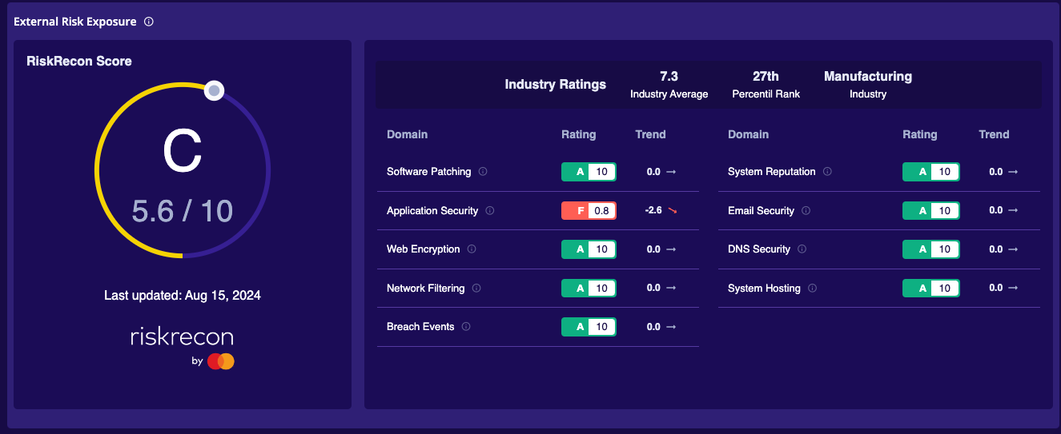
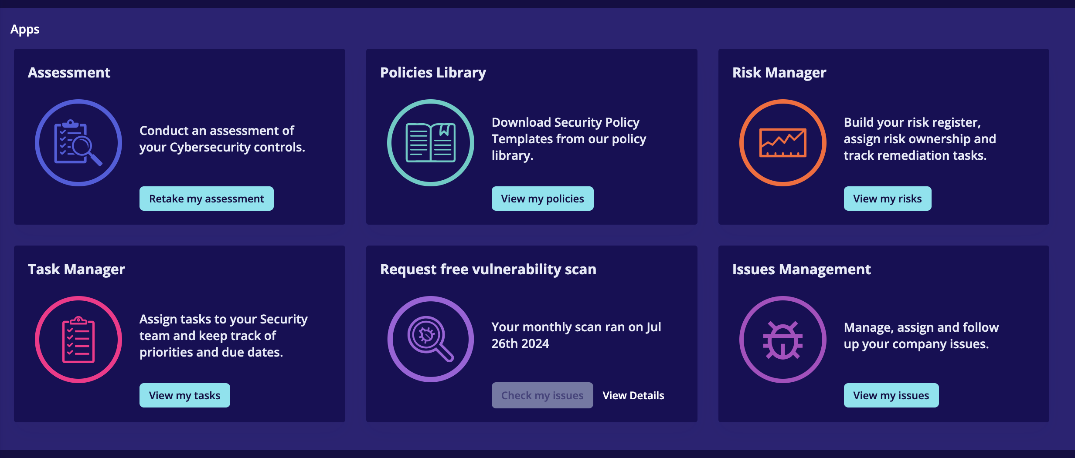
Cyvatar Platform
Cyvatar Dashboard:
RiskRecon Report by Mastercard
Security Policies Framework
Monthly External Scanning
Security Assessment
Gain essential insights that enable effective resource allocation and strategic planning, enhancing your security measures and positioning your business as a trustworthy partner

Slide 28
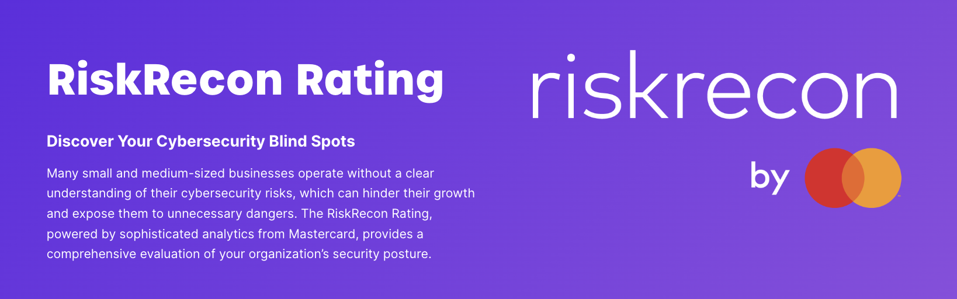
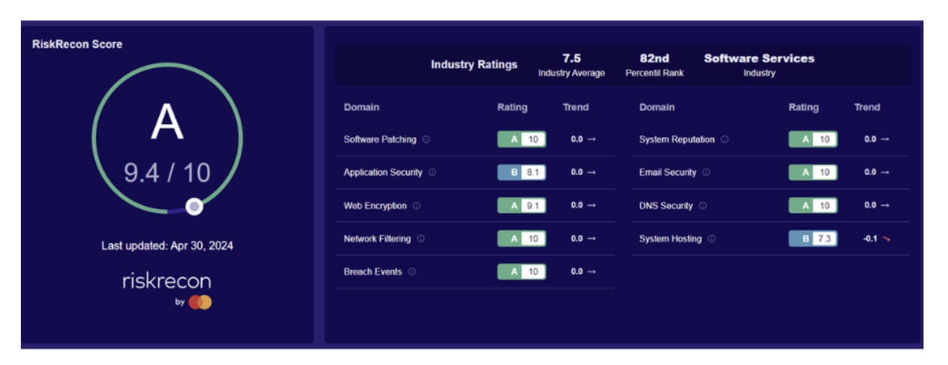
RiskRecon by Mastercard
Notes:
Cyvatar has simplified cybersecurity into the outcomes that you need by choosing the best-of-breed products and tying them to our expert team that implements the people and the process. We deliver three primary outcomes to our members, compliance, continuous preventative controls, and cybersecurity insurance in case preventive controls are bypassed.
Technology
Financial
Business Services

Slide 29
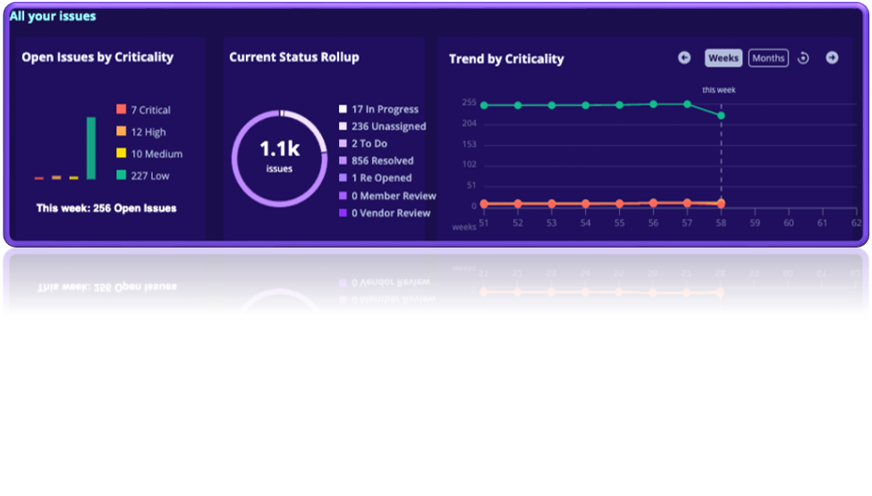
External Risk Measurements
  External Scanning
  Assesses your network and systems externally​​
  Identifies potential threats before exploitation​​
  Free of charge​
RiskRecon Rating:​
Analyzes your external security posture​
Highlights vulnerabilities at no cost

Slide 30
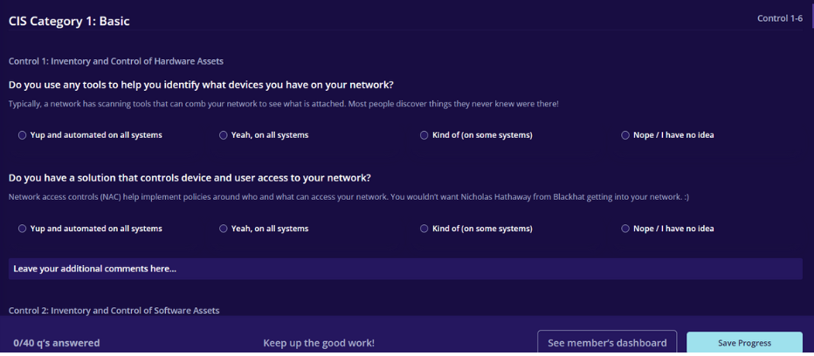
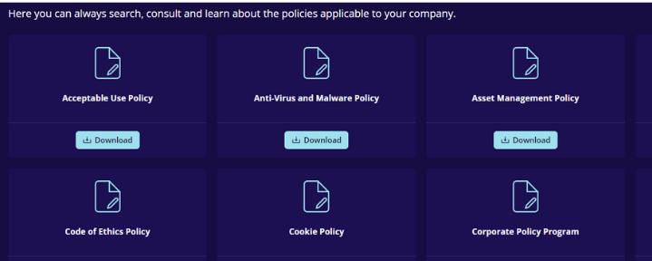
Freemium: Self Assessments & Policies
Cybersecurity Self-Assessment:​
    Comprehensive tool for internal evaluations​
    Empowers proactive security measures​
    ​
Cybersecurity Policies:​
Customizable Policy Templates​
Access a library of templates​
Tailor cybersecurity protocols to your business needs​

