Slide 1


CYBERSECURITY-AS-A-SERVICE
Notes:
Version 1

Slide 2
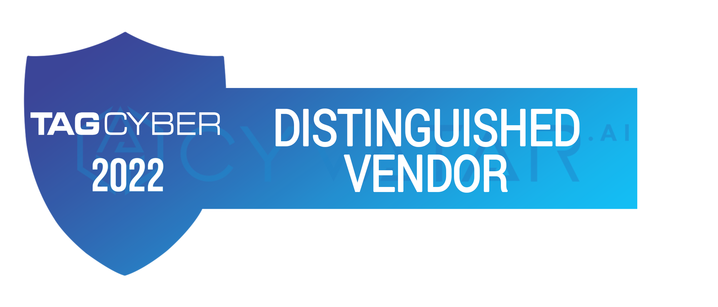


ABOUT US
Established in 2019
Founded by Corey White
A Global Team of Cyber Experts
Best & brightest minds in cybersecurity
Award Winning Cybersecurity-as-a-Service
The world's first CSaaS platform
Notes:
Access Tools – you can’t buy it
Human factor – implementation/monitoring/and human capital to plug them for you

Slide 3



OUR LEADERSHIP TEAM
CTO / Darryl Taylor
CEO / Corey White
COO / Alise Barron
Over 40 years information security experience
Managed Multiple Global Incidents
Managed Product Deployment Team
Distinguished in cybersecurity, data and content engineering, and security architecture design and implementation ​
Notes:
Change bullet point color

Slide 4
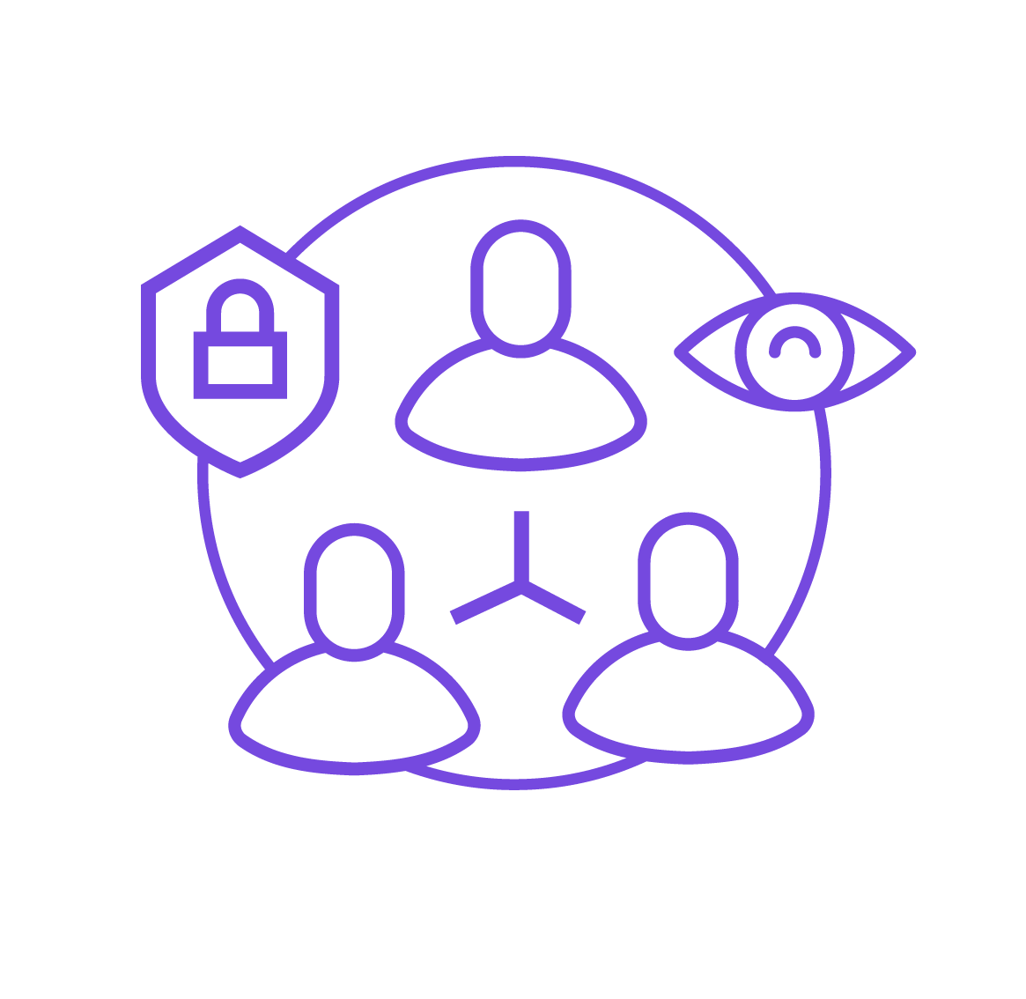


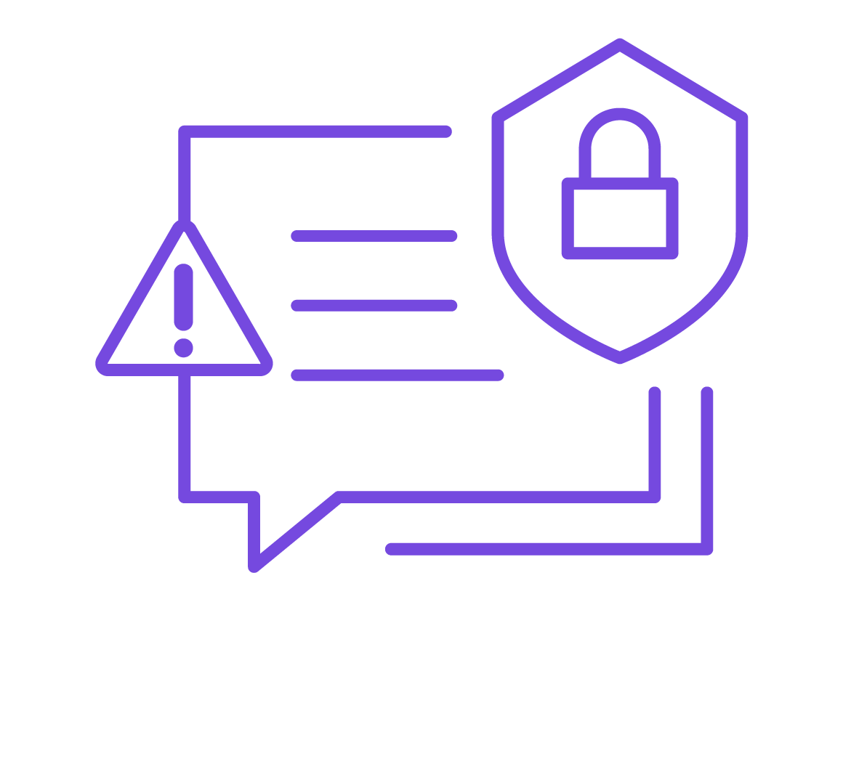

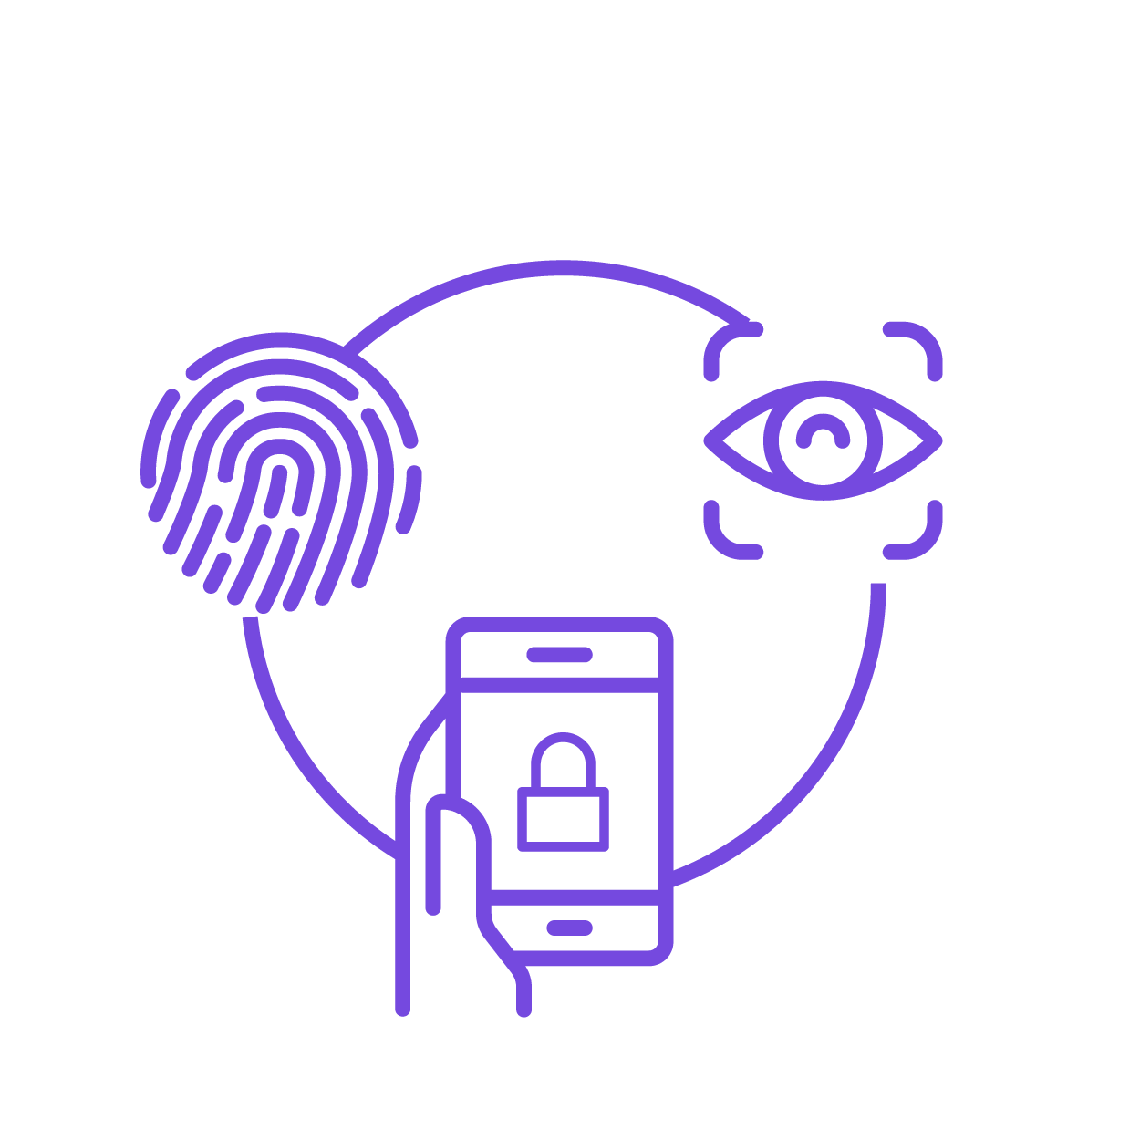
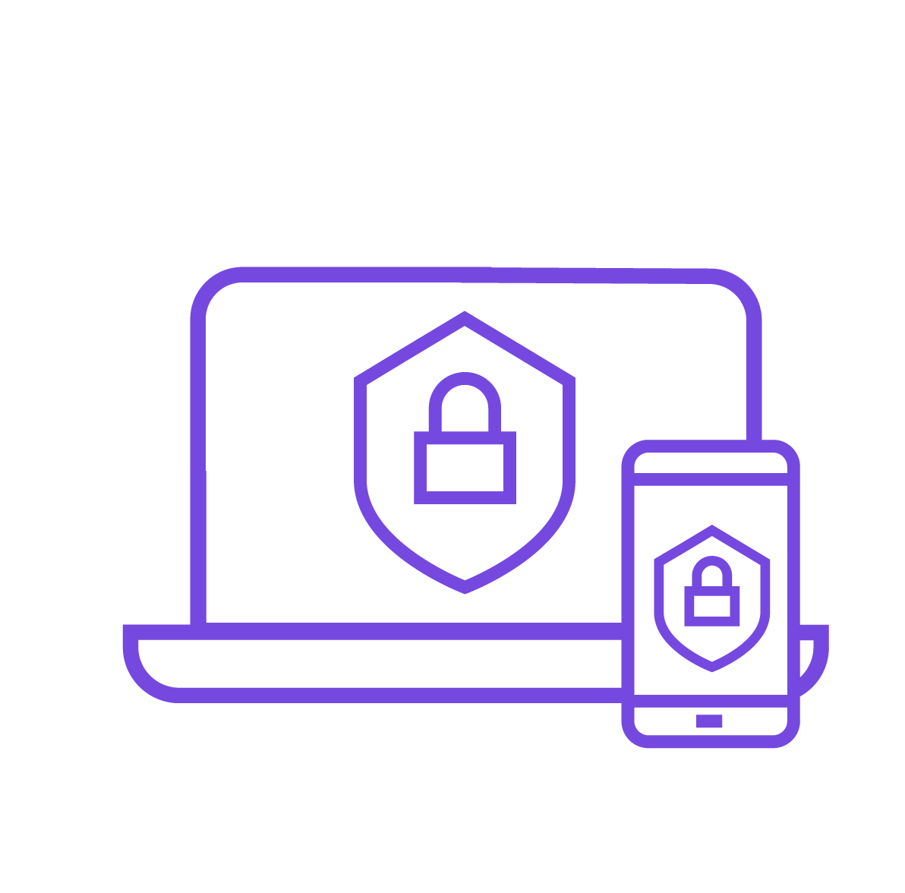


Cyvatar Freemium
Preventative Controls
Incident Response Management
Threat Vulnerability Management
Cyvatar's Solutions:
Meet your industry compliance requirements
Combines Enterprise Technology that is fully managed by our team of experts
Scale with with your business as you grow
We can help meet:
HIPAA
NIST
CIS
SOC 2 Type 2
And More!
Mobile Threat Defense
IT Asset Management
Security Awareness & Training
External
Pen-Testing
Multi-Factor Authentication
EDR (Prevent)
Next Gen Anti-Virus
Cloud SaaS Security Management
MDR
24/7 SOC
DNS Security
Management
Email Security Management

Slide 5
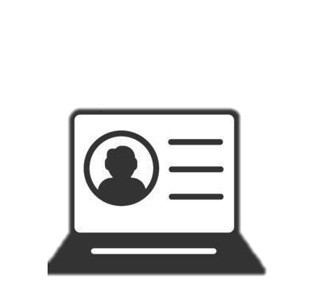
Small Business are on the front lines of Global Cyberwar
54%
OF ALL CYBER ATTACKS RESULTS IN MAJOR FINANCIAL DAMAGES RESULTING IN MORE THAN $500,000
SOME ESTIMATES INDICATE THAT
58%
OF CYBER ATTACKS ARE TARGETED AGAINST SMALL BUSINESSES
Common Attacks on SMBs:
Phishing
Malware
Ransomware
44%
OF SMALL BUSINESSES HAD AT LEAST
2 T0 4
CYBER ATTACKS
IN THE PAST YEAR
THE FINANCIAL COST CAN BE DEVISTATING:
$34,604
IS THE AVERAGE COST OF A BREACH FOR SMBs
90%
OF SMALL BUSINESSES DON’T USE ANY DATA PROTECTION

Slide 6
Recommended Solutions

Slide 7




Threat & Vulnerability Management (TVM)
Continuously find, fix, and prevent security weaknesses by understanding their causes and prevent cybersecurity breaches.
IT Asset
Management
Scanning Vulnerabilities
Patching & Remediation
External Penetration Testing
Real-Time visibility and control into all assets in the environment
Continuous scanning to detect and fix critical vulnerabilities (including AWS, Azure, GCP)
Threat Prioritization - Identifying which vulnerabilities or threats pose the highest risk to the organization based on potential impact and likelihood.
Patch Automation and Custom Scripts - Continuously patch vulnerabilities as well as address non-patchable with custom scripts.
Eliminates the need for dedicated resources to deploy and manage
Notes:
Scanning domains and subdomain – why?
Security guards 24/7 running around your building – making laps to ensure the doors are locked, that there are no bags just lying around that are not supposed to.
Locking the door analogy with a Ring Camera – seeing who is trying to come in – your neighbor or best friend is welcome, someone that wants to harm you
If they bad guy can’t make it through the front door they might try to the windows or sliding doors – that’s where we start patching and add different techniques…think window sensors, new locks, etc. – what we call in our world patching
Layer that with us working on a security testing, so as the good guy will try to break in call it a firedrill – which we do once a quarter, have you ever done a pen testing. No or Yes (how much did you spent?)

Slide 8


IT Asset Management included with
Threat & Vulnerability Management (TVM)
How Cyvatar Secures You
See Everything: Visibility into your environment: laptops, workstation, and servers.
Automatic Collection: Automatically collects software inventory data, including application details, versions and publishers.
Sensors and Custom Queries: Create custom sensors to collect additional data about applications on endpoints using natural language.
Notes:
Cyvatar has simplified cybersecurity into the outcomes that you need by choosing the best-of-breed products and tying them to our expert team that implements the people and the process. We deliver three primary outcomes to our members, compliance, continuous preventative controls, and cybersecurity insurance in case preventive controls are bypassed.

Slide 9
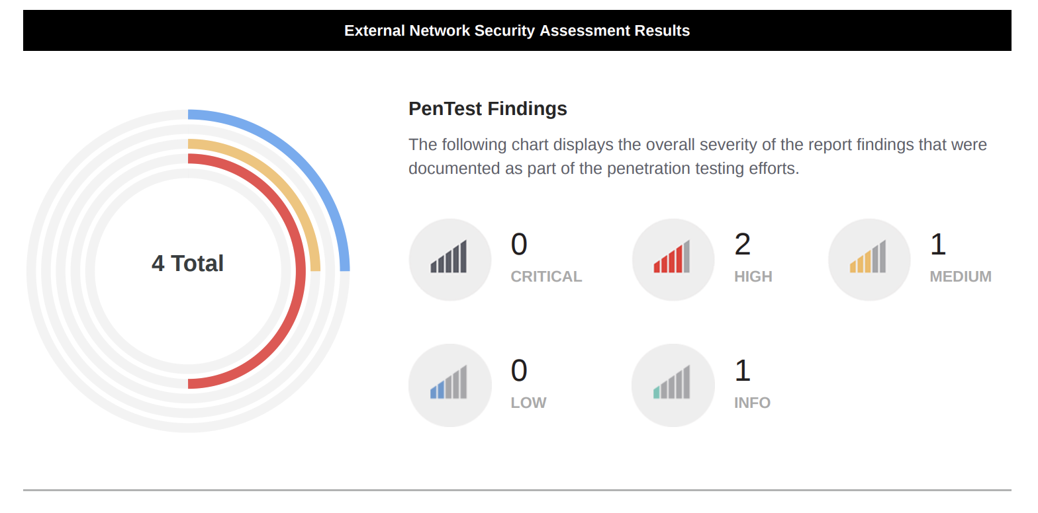
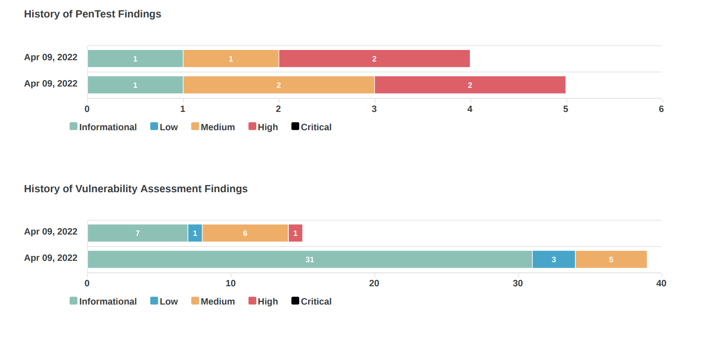
External Pen Testing included with Threat & Vulnerability Management (TVM)
How Cyvatar Secures You
Choose Quarterly or Annual Penetration Testing
Incorporates the latest knowledge, methodologies, techniques.
Meet compliance requirements with more scheduling flexibility.
Purchase a standalone or part of our Threat & Vulnerability Management (TVM) Solution to ensure we continuously scan and patch and remediate to keep you secure.
.
Notes:
Cyvatar has simplified cybersecurity into the outcomes that you need by choosing the best-of-breed products and tying them to our expert team that implements the people and the process. We deliver three primary outcomes to our members, compliance, continuous preventative controls, and cybersecurity insurance in case preventive controls are bypassed.

Slide 10
Threat & Vulnerability Management (TVM)
Continuously identify, assess, classify, remediate, and mitigate security weaknesses.
Prevent cybersecurity breaches
How Cyvatar Secures You
Installation and Configuration
Continuous Scanning: Regularly scanning and assessing networks, systems, and devices to detect vulnerabilities and threats in real time. (including AWS, Azure, GCP)
Threat Prioritization: Identifying which vulnerabilities or threats pose the highest risk to the organization based on potential impact and likelihood. Patch management in line with your change control process.
Patch Automation and Custom Scripts: Continuously patch vulnerabilities as well as address non-patchable with custom scripts.
Maintenance of the remediated status
Quarterly or Annual Penetration Testing
Monthly Executive reporting
Ongoing patching of network assets
Continuous scanning to detect and fix critical vulnerabilities
Eliminates the need for dedicated resources to deploy and manage
Notes:
Scanning domains and subdomain – why?
Security guards 24/7 running around your building – making laps to ensure the doors are locked, that there are no bags just lying around that are not supposed to.
Locking the door analogy with a Ring Camera – seeing who is trying to come in – your neighbor or best friend is welcome, someone that wants to harm you
If they bad guy can’t make it through the front door they might try to the windows or sliding doors – that’s where we start patching and add different techniques…think window sensors, new locks, etc. – what we call in our world patching
Layer that with us working on a security testing, so as the good guy will try to break in call it a firedrill – which we do once a quarter, have you ever done a pen testing. No or Yes (how much did you spent?)

Slide 11



Secure Endpoint Management (SEM)
24/7 Real-Time Protection for Endpoints against Malware and Ransomware. This strategy provides comprehensive protection while offloading the operational internal burden for your business.
EDR / Next Gen
Anti-Virus
24/7 SOC
Managed Detection & Response
Remediated
Status
Prevents against malware, ransomware and other threats
Continuous protection from known & emerging threats
Threat Hunting and Response to Incident & Playbooks and orchestration
Actionable plans for remediation of incidents
Maintenance of the remediated status
Notes:
Scanning domains and subdomain – why?
Security guards 24/7 running around your building – making laps to ensure the doors are locked, that there are no bags just lying around that are not supposed to.
Locking the door analogy with a Ring Camera – seeing who is trying to come in – your neighbor or best friend is welcome, someone that wants to harm you
If they bad guy can’t make it through the front door they might try to the windows or sliding doors – that’s where we start patching and add different techniques…think window sensors, new locks, etc. – what we call in our world patching
Layer that with us working on a security testing, so as the good guy will try to break in call it a firedrill – which we do once a quarter, have you ever done a pen testing. No or Yes (how much did you spent?)

Slide 12

Secure Endpoint Management (SEM)
A fully managed AI-based antivirus solution. The goal is to proactively secure endpoints from malware attacks and achieve a preventative state so that malware attacks are blocked before they can execute, as opposed to detect and respond.
Prevention of malware & ransomware incidents
How Cyvatar Secures You
Installation and configuration of an endpoint security solution
Remediation of malware, PUPs and memory control
Malware & Ransomware protection
Playbooks and orchestration
24/7 Monitoring and response
Maintenance of the remediated status
Monthly executive reporting
Continuous protection from known & emerging threats
Proactive threat hunting
Actionable plans for remediation of incidents
Notes:
Alarm notification, someone tries to break into the home, it will alert you and CPI 24/7 monitoring and sending the police right away to help you.
Back to the human factor – the alarms will alert us (Cyvatar) and we will manage this process.
In our world that might be someone trying to install ransomware or malware
PUP – Potential Unwanted Programs
SOC – Secure Operation Center

Slide 13




Email Security Management (ESM)
Email account compromise is the initial attack vector in 20% of cyber attacks. Phishing & Business Email Compromise affect every business. Traditional email security gateways are limited, every business needs advanced email phishing protection with prevention and detection techniques to counteract cyberattacks that launch email-based attacks.
Prevent phishing emails from costing you money
Reduces risk of Business Email Compromise
How Cyvatar Secures You
Installation and configuration of the enterprise-grade email security solution
Block malicious emails before they hit your inbox
Assessment and remediation of email security gaps
Maintenance of your environment
Monthly executive reporting
Block malicious emails before they hit your inbox
Spend less time responding to fraudulent emails

Slide 14


DNS Security Management (DSM)
Cyvatar's DNS solution offers scalable internet security that deploys quickly from the cloud, using AI to filter harmful web content and prevent access to harmful or undesirable sites.
Cloud-Based DNS Protection
How Cyvatar Secures You:
Protects against a wide array of cyber threats including malware, viruses, phishing attacks, and more, by managing access at the Domain Name System (DNS) level.
Offers a safer browsing experience by filtering internet access at the DNS level, significantly lowering the likelihood of security breaches and data loss.
Ensures user safety by continuously updating security protocols to combat emerging cyber threats, maintaining a secure online environment.
Easily integrates with existing IT infrastructure, enhancing security without complicating your network setup.
AI-Powered Content Filtering
Protection Against Online Threats
Enhanced DNS Security

Slide 15

Cloud Security Management
Gives you the visibility needed to detect and investigate breaches uncover insider threats and secure the most commonly used SaaS applications like Salesforce, Zoom, Office 365, AWS, Slack, G-Suite, Azure and more.
Connect to Critical
Applications
Protect Critical Cloud Application
Alert Management & Remediation
Connect to SaaS Apps that run your business AWS, Zoom, Office 365, G-Suite, Hubspot, Salesforce, Docusign and more.
Identify and remediate compromised cloud accounts. Ex. Impossible Travel or Brute Force
Cyvatar will mange the alerts and remediation. Receive monthly comprehensive reporting.
Notes:
Scanning domains and subdomain – why?
Security guards 24/7 running around your building – making laps to ensure the doors are locked, that there are no bags just lying around that are not supposed to.
Locking the door analogy with a Ring Camera – seeing who is trying to come in – your neighbor or best friend is welcome, someone that wants to harm you
If they bad guy can’t make it through the front door they might try to the windows or sliding doors – that’s where we start patching and add different techniques…think window sensors, new locks, etc. – what we call in our world patching
Layer that with us working on a security testing, so as the good guy will try to break in call it a firedrill – which we do once a quarter, have you ever done a pen testing. No or Yes (how much did you spent?)

Slide 16







Cloud SaaS Management (CSM)
Gives you the visibility needed to detect and investigate breaches uncover insider threats and secure the most commonly used SaaS applications like Salesforce, Zoom, Office 365, AWS, Slack, G-Suite, Azure and more.
No noise – we manage the alerts
Identify and remediate compromised cloud accounts
How Cyvatar Secures You
Cloud Assessment to identify risks within identified SaaS applications
Development of a remediation plan and schedule remediation of any gaps and risks found
Maintenance of the remediated status
Monthly executive reporting
Full visibility and board ready reporting
No additional staff requirements

Slide 17
Multi-factor Authentication Management
Cyvatar’s Multi-factor Authentication (MFA) Subscription makes it harder for attackers to penetrate networks and obtain account access. Helps prevent credential compromise. Adds protection to individuals by controlling access to applications through an additional verification capability.
Prevent credential compromise
How Cyvatar Secures You
Solution installation, configuration, assessment, remediation, and maintenance of remediated state
Secure cloud Single Sign On (SSO) solution compatible with apps like Outlook 365, Slack, AWS, Gsuite, Salesforce, and more
License Management
Measure and Analyze solution effectiveness
Monthly Executive Reporting
Reduces risk of unauthorized access
Ability to restrict user access based on location
Streamlined access based on user profile

Slide 18
Security Awareness Training (SAT)
Cyvatar’s Security Awareness Training is the key to transforming your organization’s approach to cybersecurity, moving from periodic compliance to a continuous, culture-driven model of awareness and vigilance.
Fully managed and automated
How Cyvatar Secures You:
Continuous Learning Path
Custom Content
Cyvatar works with you to build and automate a 21-course training program
Cultural Transformation
Engaging Video Content Gamified Learning Experiences
Real life simulated phishing campaigns with remedial training
Monthly Executive reporting on training outcomes (passes, fails, completions, etc.)
Cultural Transformation
Immediate remedial training if clicked thru
Over time rates to show efficacy

Slide 19
Mobile Threat Defense (MTD)
How Cyvatar Secures You:
Comprehensive Protection – Defends against malware, phishing, network attacks, and risky apps for both mobile devices and tablets.
Instant Threat Detection – Identifies threats in real-time
Proactive & Adaptive – Detects new and evolving threats in a dynamic mobile environment.
Seamless Integration – Works with existing security and mobility management solutions.
Advanced Forensics & Response – Provides in-depth attack analysis to enhance incident response.
Continuous Updates – Regularly enhances detection to combat emerging vulnerabilities.
Easy to Use App
Zero-Day Threat Detection
Forensics and Incident Response
Integration with Existing Security Infrastructure

Slide 20




Incident Response Retainer (IRM)
Establish terms and conditions for incident response services before an incident occurs. We provide attorney client privilege with breach coaching.
Enable faster and more effective response to incidents
How Cyvatar Secures You
Assistance with incident response including investigative support, malware/forensic/log analysis, remediation planning, status reporting and project management
Forensic investigation, malware analysis, reverse engineering
Repurpose unused hours for IR Readiness security services
Two hourly bundles: 24 hour & 40 hours
Prepare for the legal and financial fallout of an incident
Establish attorney client privilege
Quickly identify malicious activity

Slide 21



|
Certification Warranty $500K Program
Add-On Cyber Insurance
As a Cysurance Certified Partner, Cyvatar offers a value-added, Certification Warranty at NO COST TO QUALIFYING CUSTOMERS.
Being a Cyvatar Member enables an easy pathway to be eligible for highly discounted Cyber Insurance.
Qualifying Preventative Cyber Security Controls
Flat Fee Cyber Insurance $1M Coverage Pricing Options
Annual Company Revenue Levels | Total Annual Premium Cost
$0 - 50M | $1,750
$50 - 100M | $2,750
Threat Vulnerability Management
(TVM)
Secure Endpoint Management
(SEM)
Multi-Factor Authentication (MFA)
Flat Fee Cyber Insurance $2M Coverage Pricing Options
Adopting these preventative cyber security controls will protect your business from the financial costs associated with remediating cyberattacks.
Financial reimbursements up to $500,000 towards recovery expenses for services costs:
Annual Company Revenue Levels | Total Annual Premium Cost
$0 - 50M | $2,950
$50 - 100M | $4,000
Reimbursements | Event Description
$100,000 | Ransomware and business email compromise Events
$100,000 | Compliance and Regulatory Failure Penalties
$50,000 | Business Interruption Loss
$250,000 | Cyber Legal Liability Expenses
Flat Fee Cyber Insurance $3M Coverage Pricing Options
Annual Company Revenue Levels | Total Annual Premium Cost
$0 - 50M | $3,950
$50 - 100M | $5,000

Slide 22
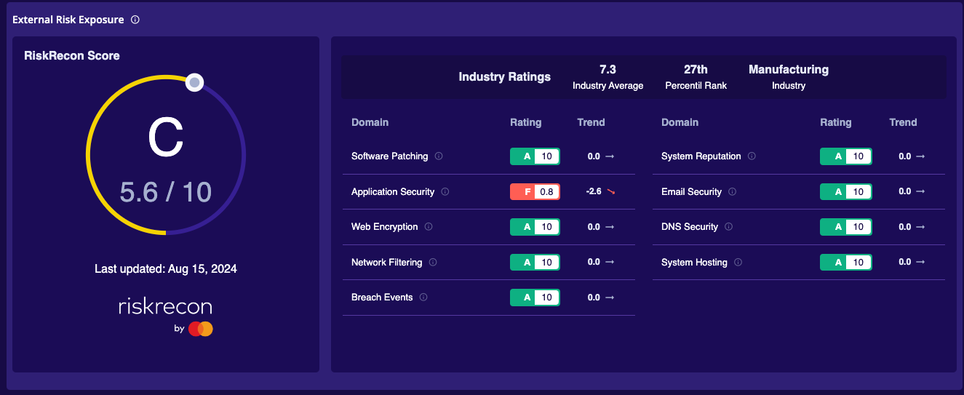
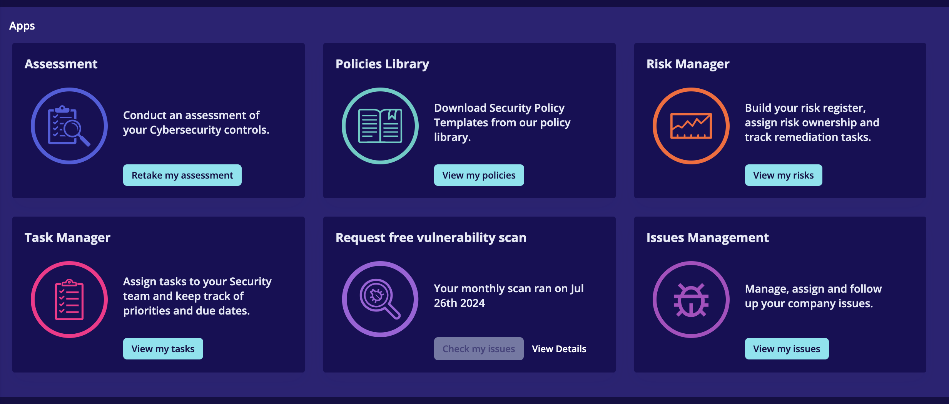
Cyvatar Platform
Cyvatar Dashboard:
RiskRecon Report by Mastercard
Security Policies Framework
Monthly External Scanning
Security Assessment
Gain essential insights that enable effective resource allocation and strategic planning, enhancing your security measures and positioning your business as a trustworthy partner

Slide 23
Simplified & Transparent Pricing
Game-changing for Cybersecurity

Slide 24
Included Items for Members
Solution | Cost per count | Reason | Total Cost
Security Policy Framework | Free with platform | Document the policies and controls available in the portal | Free
Monthly External Scanning | Free with platform | Identifies external vulnerabilities on a monthly basis | Free
Security Assessments | Free with platform | Dynamic security assessment in the platform to model security requirements and map out the best fit for Security Solutions | Free
RiskRecon powered by Mastercard | Free with platform | Gain essential insights that enable effective resource allocation and strategic planning, enhancing your security measures and positioning your business as a trustworthy partner | Free

Slide 25
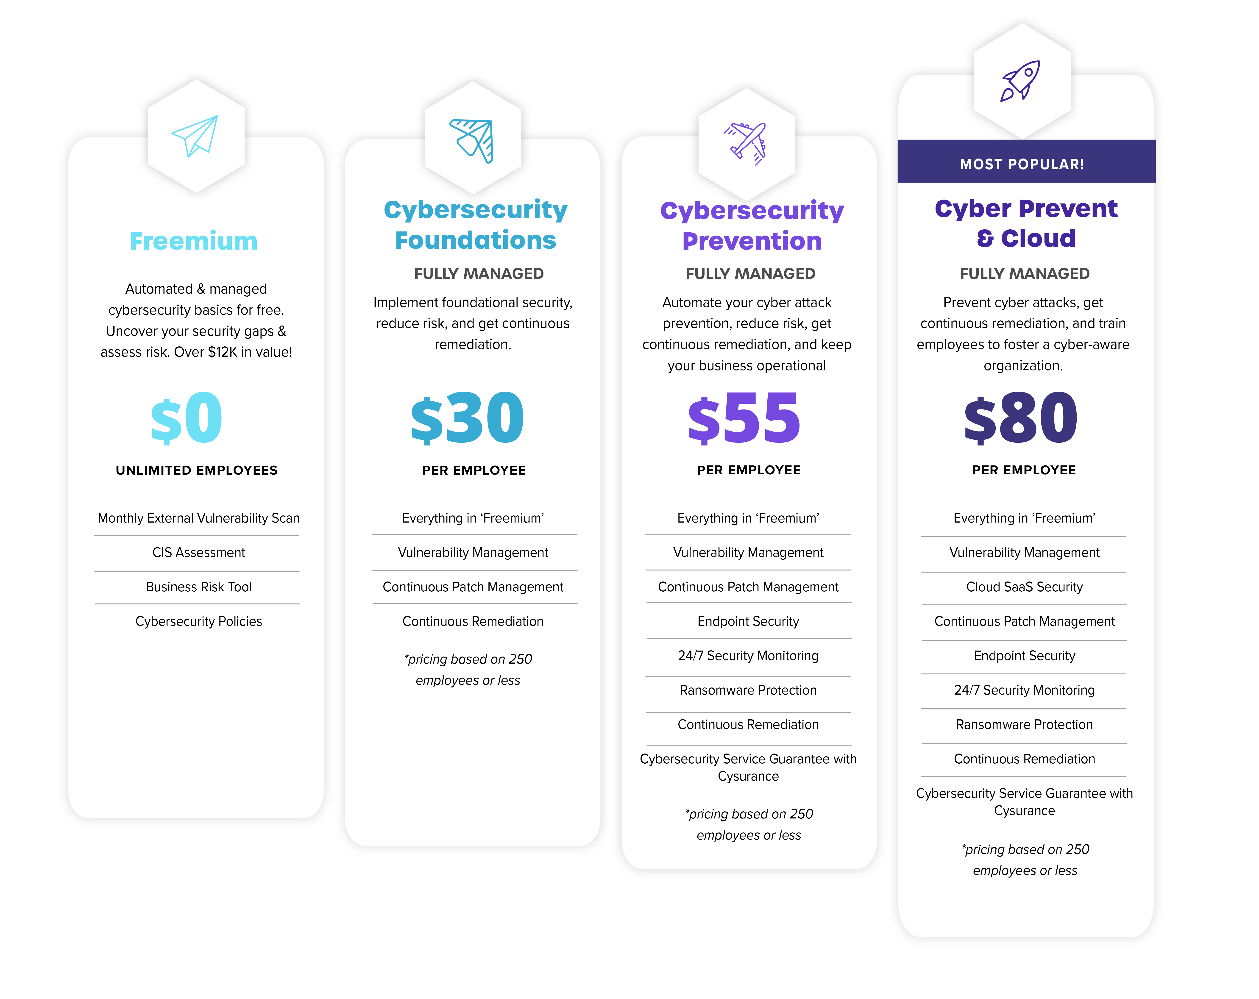
Simplified & Transparent Pricing
Game-changing for Cybersecurity

Slide 26
Proposal
Solution | Quantity | Term (Months) | List Price | Total
Threat & Vulnerability Management | 50 | 12 | $27.50 / month | $1,375.00 / month for 1 year
Secure Endpoint Management | 50 | 12 | $27.50 / month | $1,375.00 / month for 1 year
Monthly subtotal: $2,750
Total contract value: $33,000

Slide 27
Cyvatar Delivers Outcomes, Not Alerts
1
Protect your Business
Cyvatar does not focus on detection because you cannot get compliant, secure, or insured by detecting. We focus on getting our members secure and staying secure continuously by implementing & maintaining the best-of-breed solutions, which include remediation.
2
Grow your Business - Compliance & Security Questionnaires
Cyvatar has created all its solutions based on compliance requirements and mapped them to those requirements. making it seamless to get our members to a compliance state with our vast network of vCISOs and compliance auditors.
Cybersecurity Insurance
3
Cyvatar continuously delivers the preventative controls that insurance companies require. We have partnered with several top brokers to help our members get insurance.
All Members Get These Outcomes
Membership Has Its Advantages
Notes:
Cyvatar has simplified cybersecurity into the outcomes that you need by choosing the best-of-breed products and tying them to our expert team that implements the people and the process. We deliver three primary outcomes to our members, compliance, continuous preventative controls, and cybersecurity insurance in case preventive controls are bypassed.

Slide 28
Next Steps
Onboarding Experience with Cyvatar

Slide 29
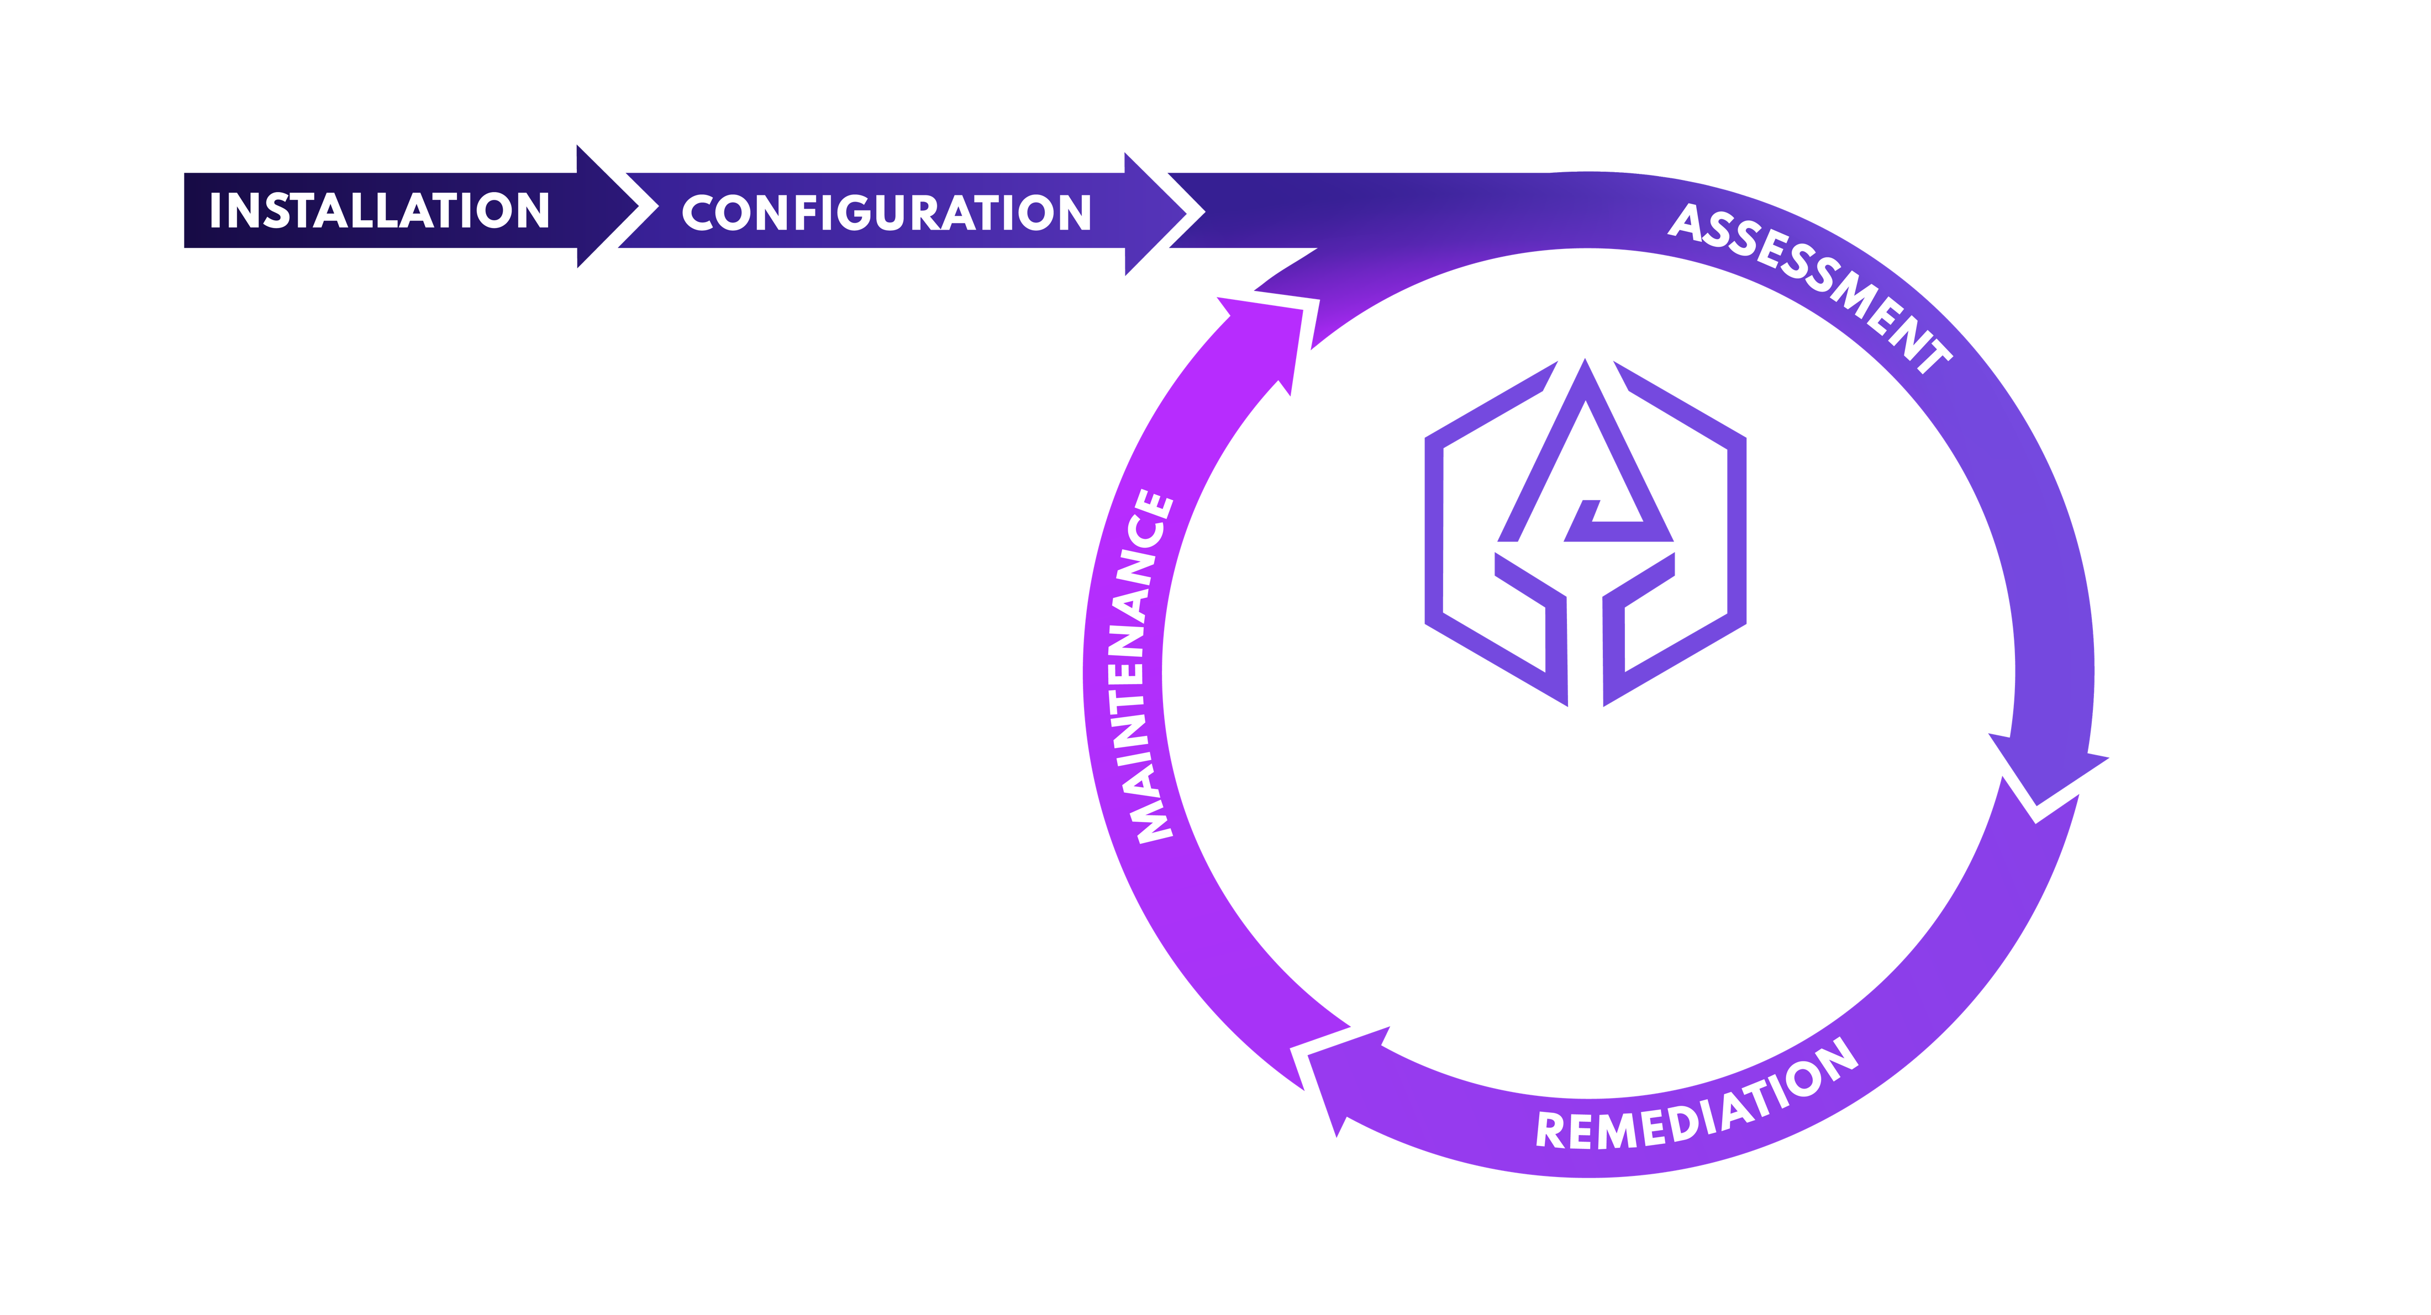
EXCLUSIVELY CYVATAR – ICARM METHODOLOGY
Installation
Our Security Engineers implement the solution.
Configuration​
The solution is configured properly to ensure its functionality.
Assessment
An assessment is performed to identify risks and vulnerabilities.
Remediation
Remediation of the risks that were identified is performed.
Maintenance
Continuous maintenance and monitoring with monthly executive reporting. Repeat.
CYBERSECURITY VALUE IS 90 DAYS OR LESS!
Notes:
MSSPs, MDRs, XDRs DON’T DO THIS – make this clear
What does remediation mean to you?

Slide 30
The Member Experience & Vendor Management
Monthly Executive Reporting
Get insight on your security and monthly performance.
No "black box" model
Gain full access and visibility into your technology stack for deeper insights.
US- Based Customer Support
Customer Support Portal or via phone or email.
Stay in the Know
Our SMEs stay informed on latest features and implement the configurations
Compliance becomes a Breeze
As compliancy requirements change lean on our expertise
We Grow with You
Effortless onboard employees and endpoints as you scale.
Vetted Best-In-Breed Technology
Continuous Research to ensure for the most effective technology stack
No more Hassle with Contracts
Cyvatar manages all contracts and renewals on your behalf
CYBERSECURITY VALUE IS 90 DAYS OR LESS!
Notes:
Cyvatar has simplified cybersecurity into the outcomes that you need by choosing the best-of-breed products and tying them to our expert team that implements the people and the process. We deliver three primary outcomes to our members, compliance, continuous preventative controls, and cybersecurity insurance in case preventive controls are bypassed.

Slide 31
Onboarding with MX
Week 1
Subscription Initiation & Planning
Weeks 2 - 4
Installation
Weeks 5 - 6
Configuration & Assessment
Weeks 8 -12
Remediation
*Continuous*
Maintenance
Sign up for MyCyvatar
Complete Assessment
Schedule Freemium scans
Download Free Security Policies
Select Solutions to purchase through eCommerce
New Subscription CyvatarPro!
Your Member Experience (MX) Manager will reach out to Welcome you to the CyFamily!
Technical Information
Enable notifications in the Cyvatar Platform and complete the data collection forms for Cyvatar Security Engineers to custom select solution product(s) that best fit your environment.
Configuration
Once installed, Cyvatar Security Engineers will lead configuration efforts based on recommended security best practices and knowledge of your unique environment needs.
Assessment
Security Engineers will assess gaps and risks and will provide recommendations that will be tracked in the Cyvatar Platform.
Remediation
Human driven. Technology assisted. Cyvatar Security Engineers will lead the remediation efforts, continuously reviewing gaps identified through the assessment.
Cyvatar Security Engineers will develop, plan, schedule, and execute remediation until identified gaps are remediated, to the extent reasonably possible.
This will reduce the quantity of issues and actions needed by your team so you can focus on your bottom line.
Maintain Remediated Status
Security Engineers will lead maintenance efforts, continuously assessing the environment & remediating vulnerabilities identified so you can stay safe and compliant.
ROI Visibility
With the Cyvatar Platform you have visibility into Cyvatar’s daily activities that keep you safe, all in one place.
Member Experience
Your MX Manager will stay connected to ensure your Cyber Security journey is aligned with your strategic objectives.
Installation
Acting as an extension of your team, Cyvatar Security Engineers will assist with installation of the relevant 3rd Party Product(s) by providing installation instructions, and hands on guidance. While always having your back through any strategizing or troubleshooting.
ICARM Onboarding Visibility
Progress is tracked through the Cyvatar Platform with the Cybersecurity Value Score, task manager, issues manager, and detailed dashboard.
Monthly Executive Reporting via Cyvatar platform.
Ad-hoc working sessions will be scheduled on as needed basis.

Slide 32
Appendix

Slide 33
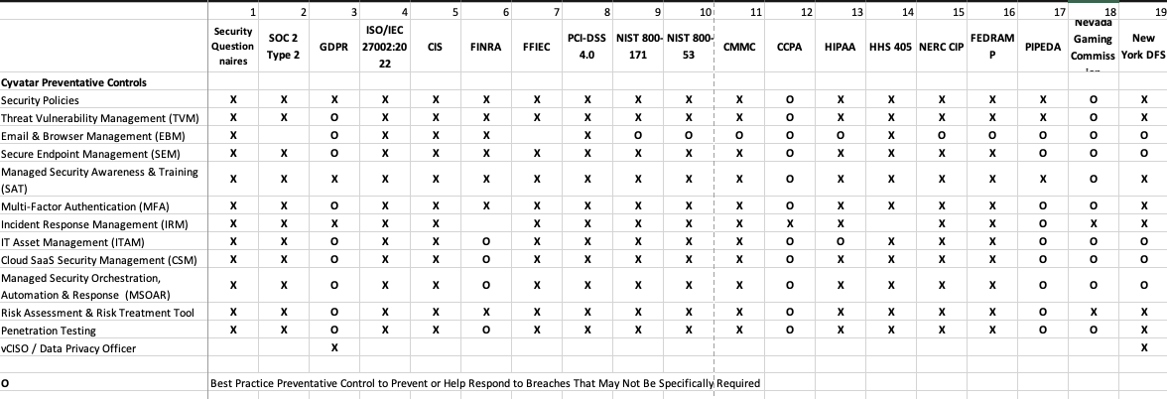
Cyvatar Compliance Mapping
Note: These solutions do not meet every single requirement in detail

Slide 34
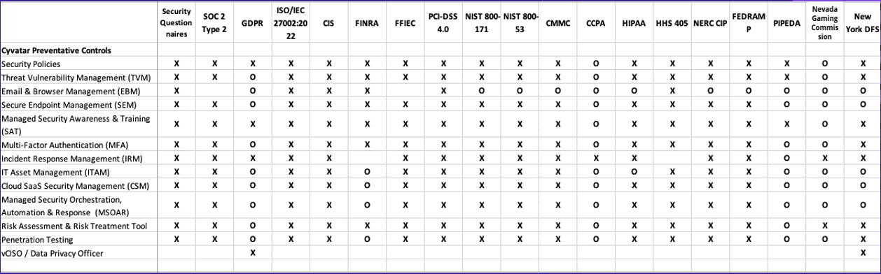
Cyvatar Compliance Mapping
*These solutions do not meet every single requirement in detail
34

Slide 35
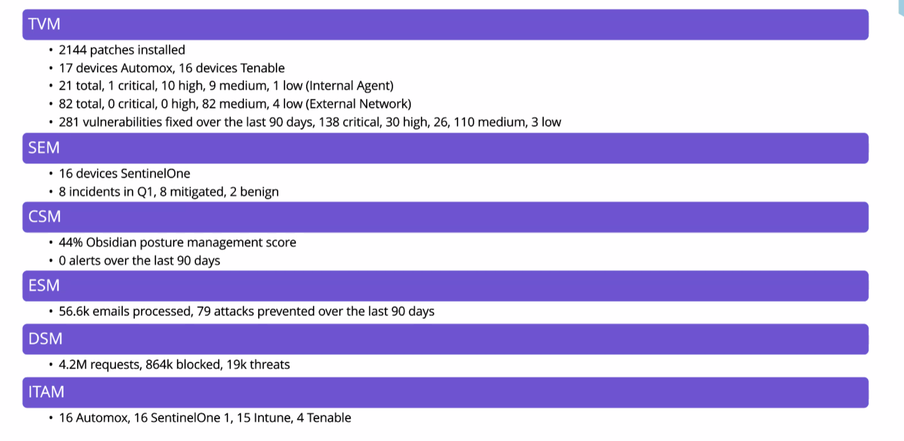
Sample Security Activity over a Quarter

Slide 36
Threat – Phishing Email EMS
DNS
SEM
TVM

